Slide 1
Impact of pre-transplant anti-fibrotic therapy for IPF upon lung transplant outcomes
Astor TL et al. Impact of pre-transplant anti-fibrotic therapy for IPF upon lung transplant outcomes. Poster developed for the American Thoracic Society International Conference, 2020.

Slide 2
Introduction
Nintedanib and pirfenidone are anti-fibrotic medications that slow the progression of idiopathic pulmonary fibrosis (IPF)
Concern has been raised that anti-fibrotic medications may increase the risk of post-transplant complications such as delayed incisional healing or sternal or anastomotic dehiscence
More data are needed on whether continuing antifibrotic therapy until the time of lung transplant increases the risk of complications
Astor TL et al. Impact of pre-transplant anti-fibrotic therapy for IPF upon lung transplant outcomes. Poster developed for the American Thoracic Society International Conference, 2020.

Slide 3
Aim
To describe variations in intra-operative and post-transplant complications in patients with IPF grouped by the time between discontinuation of anti-fibrotic therapy and lung transplant
Astor TL et al. Impact of pre-transplant anti-fibrotic therapy for IPF upon lung transplant outcomes. Poster developed for the American Thoracic Society International Conference, 2020.

Slide 4
Study
This study (clinicaltrials.gov NCT04316780) included patients with IPF listed for lung transplantation between 1 July 2015 and 30 June 2019, who had been treated with nintedanib or pirfenidone continuously for ≥90 days at the time of listing for transplantation
Patients who underwent additional interventions (e.g. coronary artery bypass grafting, valve replacement) at the time of their lung transplant were excluded
Astor TL et al. Impact of pre-transplant anti-fibrotic therapy for IPF upon lung transplant outcomes. Poster developed for the American Thoracic Society International Conference, 2020.

Slide 5
Analyses
We used data from medical records to assess complications during and in the 6 months after transplant in three groups of patients, based on the time between discontinuation of anti-fibrotic medication and transplant:
Analyses were descriptive.
Astor TL et al. Impact of pre-transplant anti-fibrotic therapy for IPF upon lung transplant outcomes. Poster developed for the American Thoracic Society International Conference, 2020.

Slide 6
Patients
The analysis included 297 patients from 9 centers (107 taking nintedanib, 190 taking pirfenidone)
Most patients (nintedanib 70%, pirfenidone 72%) were categorized into group 1
Astor TL et al. Impact of pre-transplant anti-fibrotic therapy for IPF upon lung transplant outcomes. Poster developed for the American Thoracic Society International Conference, 2020.

Slide 7
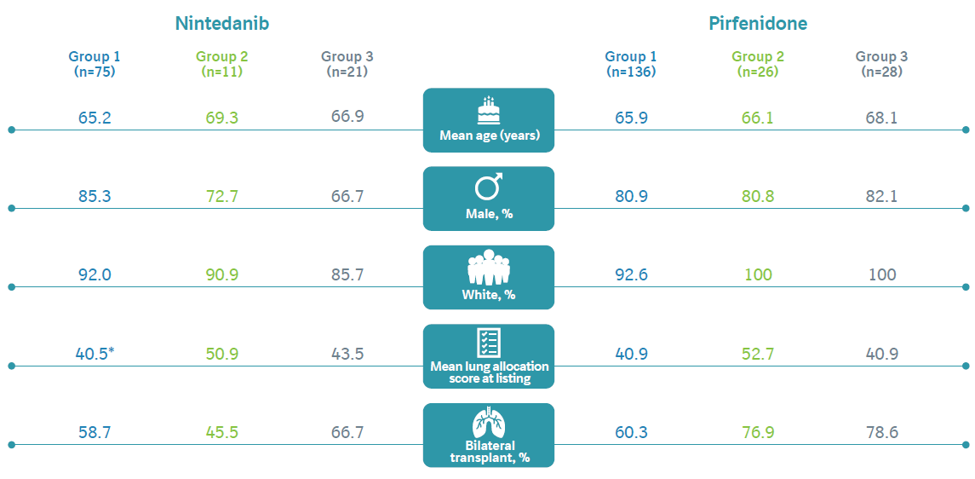
Patient characteristics at time of listing for transplantation
*Information not available for one patient.
Astor TL et al. Impact of pre-transplant anti-fibrotic therapy for IPF upon lung transplant outcomes. Poster developed for the American Thoracic Society International Conference, 2020.

Slide 8
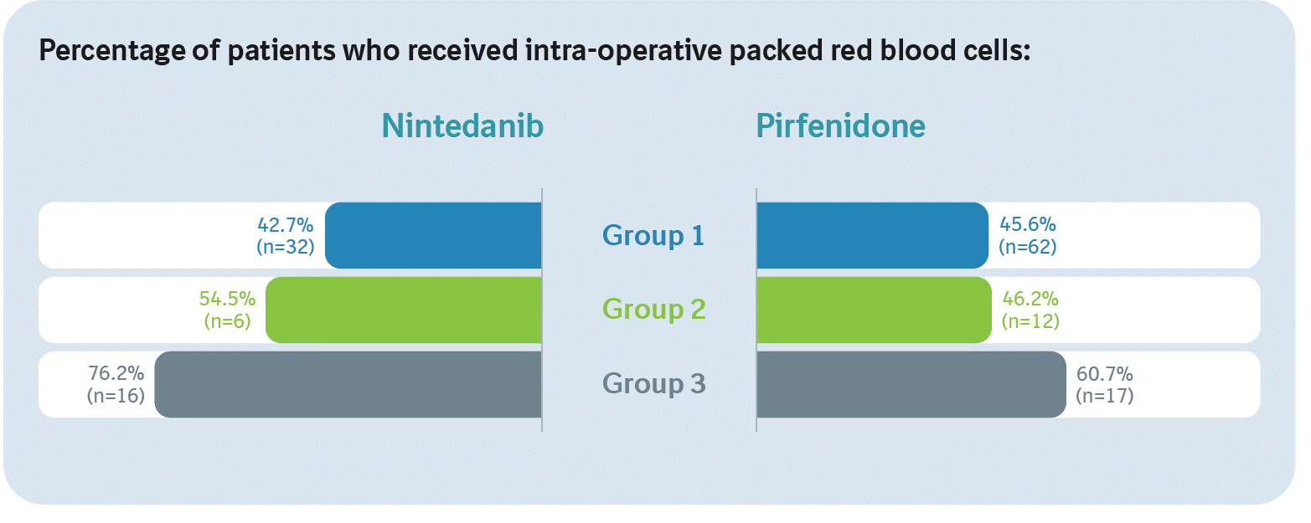
Intra-operative red blood cell transfusion
Astor TL et al. Impact of pre-transplant anti-fibrotic therapy for IPF upon lung transplant outcomes. Poster developed for the American Thoracic Society International Conference, 2020.

Slide 9
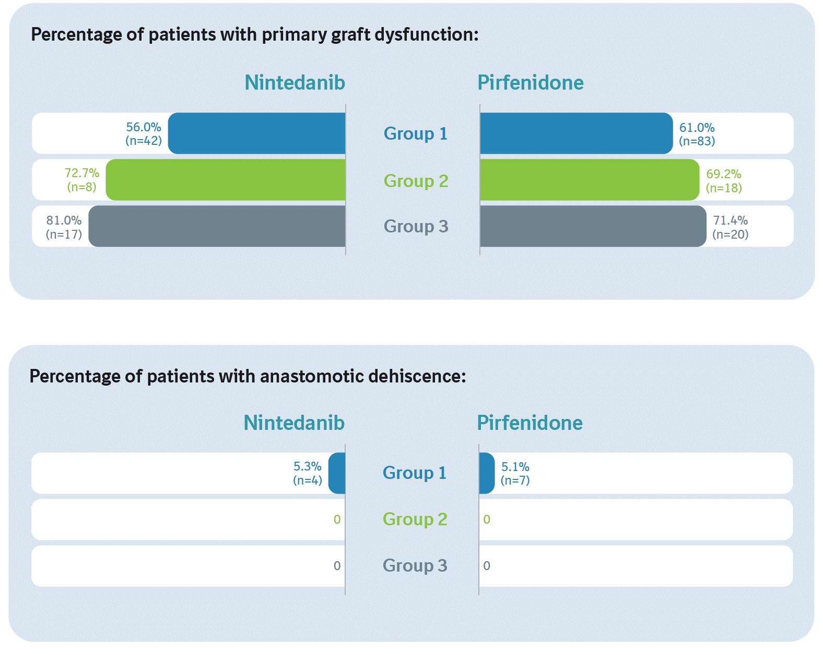
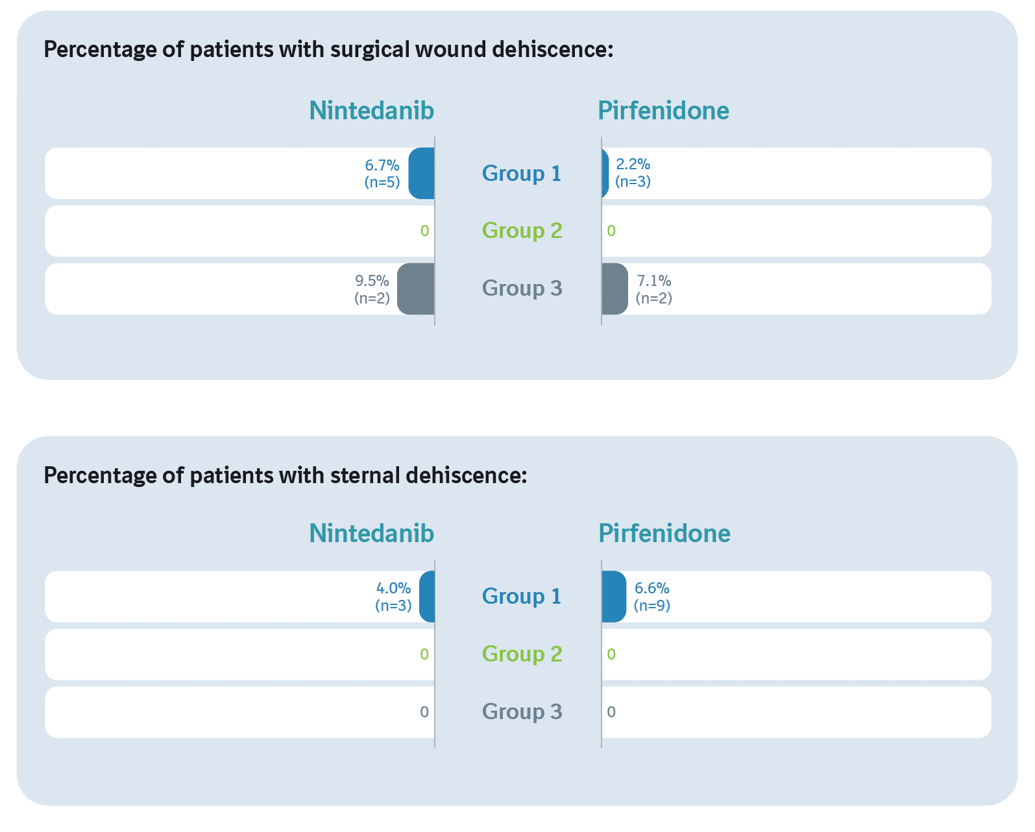
Primary graft dysfunction, anastomotic dehiscence, surgical wound dehiscence and sternal dehiscence
Astor TL et al. Impact of pre-transplant anti-fibrotic therapy for IPF upon lung transplant outcomes. Poster developed for the American Thoracic Society International Conference, 2020.

Slide 10
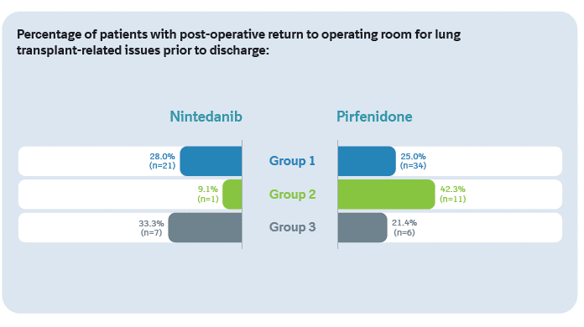
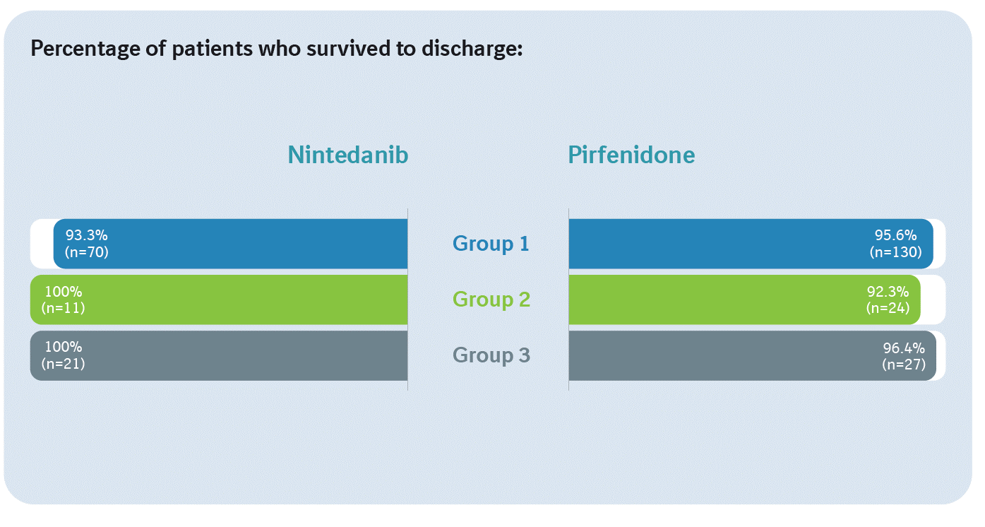
Post-operative return to operating room and survival to discharge
Astor TL et al. Impact of pre-transplant anti-fibrotic therapy for IPF upon lung transplant outcomes. Poster developed for the American Thoracic Society International Conference, 2020.

Slide 11
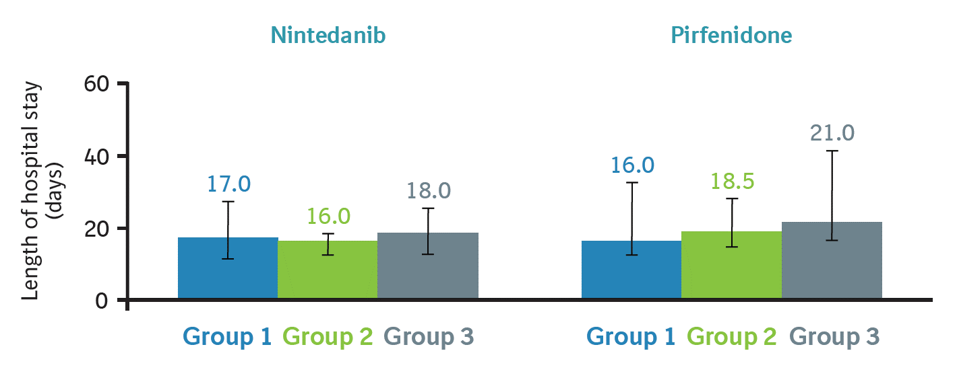
Length of hospital stay
Median (IQR) length of hospital stay (days) in patients who survived to discharge (n=283):
Error bars indicate interquartile range (IQR).
Astor TL et al. Impact of pre-transplant anti-fibrotic therapy for IPF upon lung transplant outcomes. Poster developed for the American Thoracic Society International Conference, 2020.

Slide 12
Conclusions
This observational study indicates variability in the use of anti-fibrotic drugs prior to lung transplant in patients with IPF
Descriptive analyses did not suggest differences in the following outcomes depending on when anti-fibrotic therapy was discontinued relative to transplant: need for intra-operative red blood cell transfusion; primary graft dysfunction; surgical wound dehiscence; survival to discharge; length of stay in hospital
Anastomotic and sternal dehiscence were only seen in patients whose anti-fibrotic therapy was discontinued <5 medication half-lives prior to transplant; however, these events were infrequent
The possibility of disease acceleration and waitlist death with cessation of anti-fibrotic therapy at listing needs to be balanced against the potential for intra- and post-operative complications related to anti-fibrotic therapy
Further study is needed to determine the optimal time to discontinue anti-fibrotic drugs prior to lung transplant
Astor TL et al. Impact of pre-transplant anti-fibrotic therapy for IPF upon lung transplant outcomes. Poster developed for the American Thoracic Society International Conference, 2020.

Slide 13
Acknowledgements
This study was funded by Boehringer Ingelheim Pharmaceuticals, Inc (BIPI).
The sites that enrolled patients in this study were: Massachusetts General Hospital, Boston, MA; Brigham and Women’s Hospital, Boston, MA; Duke University, Durham, NC; University of Pennsylvania, Philadelphia, PA; Washington University, St. Louis, MO; University of Iowa, Iowa City, IA; Temple University, Philadelphia, PA; Cleveland Clinic, Cleveland, OH; St. Elizabeth’s Medical Center, Boston, MA. The ILD Collaborative, Boston, MA, and Tufts University, Boston, MA, acted as the bioinformatics co-ordinating site and data analysis site, respectively.
Editorial and formatting assistance was provided by Elizabeth Ng and Wendy Morris of FleishmanHillard Fishburn, which was contracted and funded by BIPI. The authors meet criteria for authorship as recommended by the International Committee of Medical Journal Editors (ICMJE), received no direct compensation for the development of the poster, were fully responsible for all content and editorial decisions, were involved at all stages of development and have approved the final version. BI was given the opportunity to review the poster for medical and scientific accuracy as well as intellectual property considerations.

