Slide 1
Effect of nintedanib in patients with limited and extensive systemic sclerosis-associated interstitial lung disease: data from the SENSCIS® trial
Goh N et al. Effect of nintedanib in patients with limited and extensive systemic sclerosis-associated interstitial lung disease: data from the SENSCIS trial. Poster developed for the American Thoracic Society International Conference, 2020.

Slide 2
Introduction
ILD is the leading cause of death in patients with SSc¹
In the SENSCIS trial in subjects with SSc-ILD, nintedanib reduced the rate of decline in FVC (mL/year) over 52 weeks by 44% versus placebo²
Previous studies have suggested that patients with SSc-ILD who have more extensive fibrotic ILD on an HRCT scan have a worse prognosis than patients with less extensive disease^{3,4}
ILD, interstitial lung disease; SSc, systemic sclerosis; FVC, forced vital capacity; HRCT, high-resolution computed tomography.
1. Elhai M et al. Ann Rheum Dis 2017;76:1897–905; 2. Distler O et al. N Engl J Med 2019;380:2518–28; 3. Goh NS et al. Am J Respir Crit Care Med 2008;177:1248–54;
4. Hoffmann-Vold AM et al. Am J Respir Crit Care Med 2019;200:1258–66.
Goh N et al. Effect of nintedanib in patients with limited and extensive systemic sclerosis-associated interstitial lung disease: data from the SENSCIS trial. Poster developed for the American Thoracic Society International Conference, 2020.

Slide 3
Aim
To assess the effect of nintedanib in subjects with limited and extensive SSc-ILD in the SENSCIS trial
Goh N et al. Effect of nintedanib in patients with limited and extensive systemic sclerosis-associated interstitial lung disease: data from the SENSCIS trial. Poster developed for the American Thoracic Society International Conference, 2020.

Slide 4
Methods
Inclusion criteria included SSc with first non-Raynaud symptom <7 years before screening, FVC ≥40% predicted and DLco 30–89% predicted
Subjects had fibrotic ILD of ≥10% extent on an HRCT scan taken in the last ≤12 months, confirmed by central review. The extent of fibrotic ILD was assessed visually in the whole lung to the nearest 5%. The assessment did not include pure (non-fibrotic) ground glass opacities
Subjects on prednisone ≤10 mg/day and/or stable therapy with mycophenolate or methotrexate for ≥6 months prior to randomization were allowed to participate
Subjects were randomized 1:1 to receive nintedanib or placebo
DLco, diffusion capacity of the lung for carbon monoxide.
Goh N et al. Effect of nintedanib in patients with limited and extensive systemic sclerosis-associated interstitial lung disease: data from the SENSCIS trial. Poster developed for the American Thoracic Society International Conference, 2020.
Notes:
Table 1.1.74.2.1
Table 1.1.74.10.1
Table 1.1.74.12.1

Slide 5
Analyses
Analyses performed:
Rate of decline in FVC (mL/year) and categorical declines in FVC or death over 52 weeks in subjects with limited and extensive ILD at baseline
Rate of decline in FVC (mL/year) over 52 weeks in subgroups by extent of fibrotic ILD on HRCT (≥30% and <30%) and FVC (<70% and ≥70% predicted) at baseline
Interaction p-values were calculated to assess potential heterogeneity in the treatment effect of nintedanib versus placebo between subgroups. No adjustment for multiplicity was made
Goh N et al. Effect of nintedanib in patients with limited and extensive systemic sclerosis-associated interstitial lung disease: data from the SENSCIS trial. Poster developed for the American Thoracic Society International Conference, 2020.
Notes:
Table 1.1.74.2.1
Table 1.1.74.10.1
Table 1.1.74.12.1

Slide 6
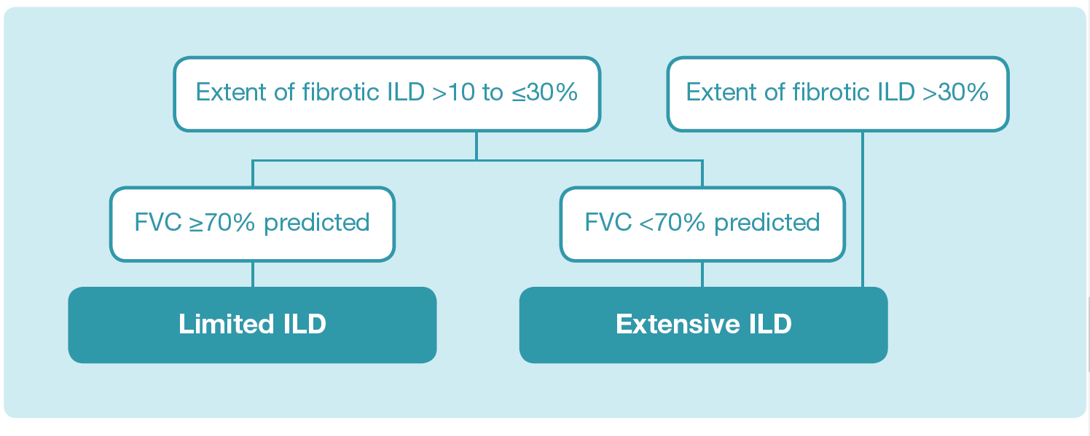
Limited and extensive ILD
Subjects on prednisone ≤10 mg/day and/or stable therapy with mycophenolate or methotrexate for ≥6 months prior to randomization were allowed to participate.
Subjects were randomized 1:1 to receive nintedanib or placebo.
Goh N et al. Effect of nintedanib in patients with limited and extensive systemic sclerosis-associated interstitial lung disease: data from the SENSCIS trial. Poster developed for the American Thoracic Society International Conference, 2020.
Notes:
Table 1.1.74.2.1
Table 1.1.74.10.1
Table 1.1.74.12.1

Slide 7
Baseline characteristics
Subjects with extensive ILD had:
Goh N et al. Effect of nintedanib in patients with limited and extensive systemic sclerosis-associated interstitial lung disease: data from the SENSCIS trial. Poster developed for the American Thoracic Society International Conference, 2020.

Slide 8
Baseline characteristics
Extensive ILD (n=358) |  | Limited ILD (n=218)
72.9% | Female | 78.9%
53.1 (12.3) | Age (years) | 55.3 (11.9)
26.1 (5.1) | BMI (kg/m²) | 25.5 (4.8)
3.5 | Years since first non-Raynaud’s symptom (median) | 3.2
54.2% | dcSSc | 48.2%
61.5% | ATA positive | 59.6%
11.8 (9.4) | mRSS | 10.0 (8.2)
2325 (752) | FVC (mL) | 2787 (732)
66.1 (14.9) | FVC % predicted | 83.1 (13.9)
48.9 (14.2) | DLco % predicted | 59.7 (14.1)
48.0% | Taking mycophenolate mofetil | 44.0%
% of subjects or mean (SD) unless otherwise stated. ATA, anti-topoisomerase I antibody; dcSSc, diffuse cutaneous SSc; mRSS, modified Rodnan skin score.
Goh N et al. Effect of nintedanib in patients with limited and extensive systemic sclerosis-associated interstitial lung disease: data from the SENSCIS trial. Poster developed for the American Thoracic Society International Conference, 2020.

Slide 9
Rate of decline in FVC in placebo group
Goh N et al. Effect of nintedanib in patients with limited and extensive systemic sclerosis-associated interstitial lung disease: data from the SENSCIS trial. Poster developed for the American Thoracic Society International Conference, 2020.

Slide 10
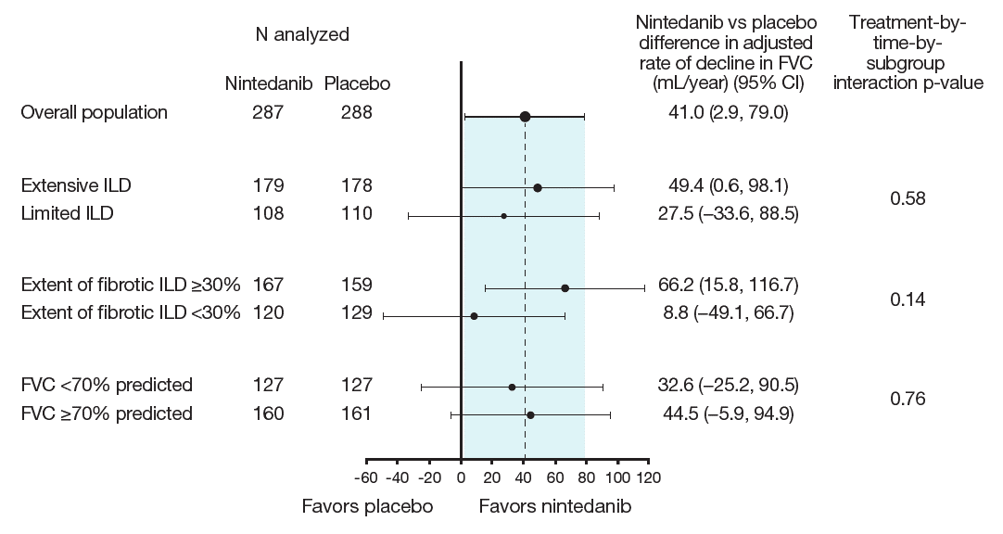
Rate of decline in FVC (mL/year) with nintedanib versus placebo
Goh N et al. Effect of nintedanib in patients with limited and extensive systemic sclerosis-associated interstitial lung disease: data from the SENSCIS trial. Poster developed for the American Thoracic Society International Conference, 2020.

Slide 11
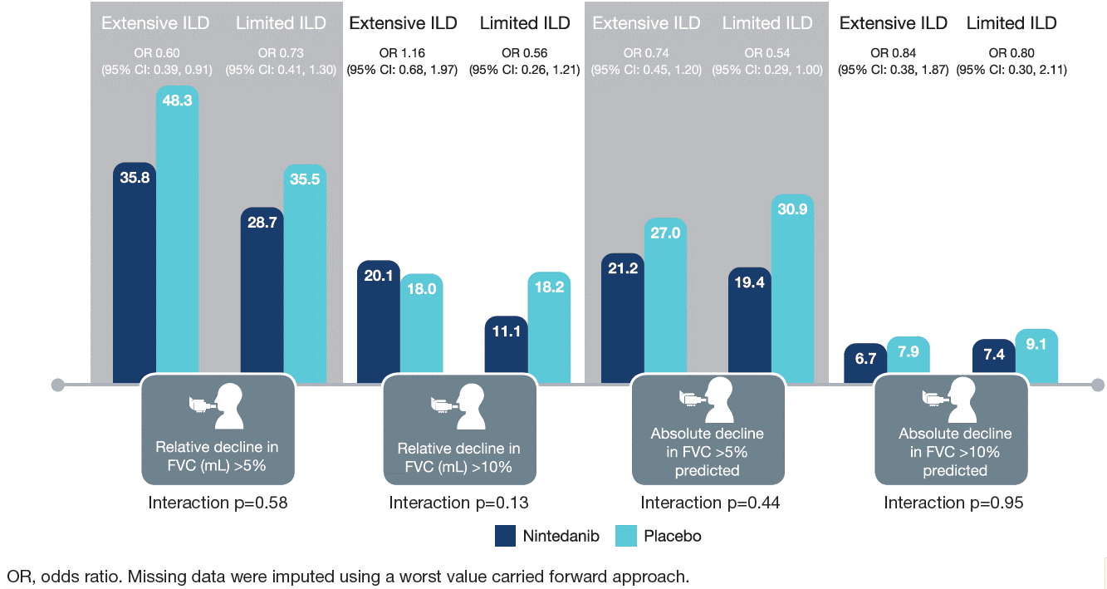
Categorical declines in FVC at week 52
Missing data were imputed using a worst value carried forward approach.
Goh N et al. Effect of nintedanib in patients with limited and extensive systemic sclerosis-associated interstitial lung disease: data from the SENSCIS trial. Poster developed for the American Thoracic Society International Conference, 2020.

Slide 12
Proportion of subjects who had an absolute decline in FVC ≥10% predicted or died over 52 weeks
Treatment-by-subgroup interaction p=0.98. Missing data were imputed using a worst value carried forward approach.
Goh N et al. Effect of nintedanib in patients with limited and extensive systemic sclerosis-associated interstitial lung disease: data from the SENSCIS trial. Poster developed for the American Thoracic Society International Conference, 2020.

Slide 13
Adverse events
 | Extensive ILD |  | Limited ILD
 | Nintedanib (n=180) | Placebo (n=178) | Nintedanib (n=108) | Placebo (n=110)
Most frequent adverse events*
Diarrhea | 140 (77.8) | 50 (28.1) | 78 (72.2) | 41 (37.3)
Nausea | 52 (28.9) | 21 (11.8) | 39 (36.1) | 18 (16.4)
Vomiting | 40 (22.2) | 19 (10.7) | 31 (28.7) | 11 (10.0)
Skin ulcer | 30 (16.7) | 30 (16.9) | 23 (21.3) | 20 (18.2)
Nasopharyngitis | 24 (13.3) | 29 (16.3) | 12 (11.1) | 20 (18.2)
Weight decreased | 24 (13.3) | 9 (5.1) | 10 (9.3) | 3 (2.7)
Cough | 22 (12.2) | 33 (18.5) | 12 (11.1) | 19 (17.3)
Upper respiratory tract infection | 20 (11.1) | 22 (12.4) | 13 (12.0) | 13 (11.8)
Fatigue | 17 (9.4) | 11 (6.2) | 14 (13.0) | 9 (8.2)
Abdominal pain | 16 (8.9) | 11 (6.2) | 17 (15.7) | 10 (9.1)
Adverse event(s) leading to treatment discontinuation | 30 (16.7) | 16 (9.0) | 16 (14.8) | 9 (8.2)
Serious adverse event(s)† | 42 (23.3) | 43 (24.2) | 27 (25.0) | 19 (17.3)
Fatal adverse event | 4 (2.2) | 3 (1.7) | 1 (0.9) | 1 (0.9)
Data are n (%) of subjects with ≥1 such adverse event reported over 52 weeks (or until 28 days after last trial drug intake for subjects who discontinued trial drug before week 52).
Adverse events were coded based on preferred terms in the Medical Dictionary for Regulatory Activities (MedDRA). *Reported in >10% of the overall population.
†Adverse event that resulted in death, was life-threatening, resulted in hospitalization or prolongation of hospitalization, resulted in persistent or clinically significant disability or incapacity, was a congenital anomaly or birth defect, or was deemed to be serious for any other reason.
Goh N et al. Effect of nintedanib in patients with limited and extensive systemic sclerosis-associated interstitial lung disease: data from the SENSCIS trial. Poster developed for the American Thoracic Society International Conference, 2020.

Slide 14
Conclusions
In the SENSCIS trial in subjects with SSc-ILD, the rate of decline in FVC in the placebo group was numerically greater in subjects with an extent of fibrotic ILD on HRCT ≥30% than <30% and with FVC <70% than ≥70% predicted at baseline
Nintedanib reduced the rate of decline in FVC both in subjects with extensive ILD and limited ILD at baseline.
Goh N et al. Effect of nintedanib in patients with limited and extensive systemic sclerosis-associated interstitial lung disease: data from the SENSCIS trial. Poster developed for the American Thoracic Society International Conference, 2020.

Slide 15
Acknowledgements
The SENSCIS trial was funded by Boehringer Ingelheim
Editorial and formatting assistance, supported financially by Boehringer Ingelheim, was provided by Elizabeth Ng and Wendy Morris of FleishmanHillard Fishburn, London, UK, during preparation of the poster on which these slides were based. The authors were fully responsible for all content and editorial decisions, were involved at all stages of poster development and have approved the final version. The authors received no direct compensation related to the development of the poster or slides. Boehringer Ingelheim was given the opportunity to review the poster for medical and scientific accuracy as well as intellectual property considerations

