Slide 1
In-hospital mortality in patients with idiopathic pulmonary fibrosis (IPF)
Judy J et al. In-hospital mortality in patients with idiopathic pulmonary fibrosis. Poster developed for the American Thoracic Society International Conference, 2020.

Slide 2
Introduction
Hospitalizations are common in patients with IPF and are associated with high mortality^{1–3}
The Premier Healthcare Database is a broadly representative dataset that includes >20% of US hospital admissions
Based on this database, among patients with IPF hospitalized between Oct 2011 and Oct 2014 (n=6665):
In-hospital mortality was ~14%³
Average length of hospital stay was ~5 days³
Two antifibrotic drugs, nintedanib and pirfenidone, were approved for the treatment of IPF in the US in October 2014
1. Brown AW et al. Chest 2015;147:173–79. 2. Mooney JJ et al. J Med Econ 2017;20:518–24. 3. Durheim MT et al. Lung 2019;197:699–707.
Judy J et al. In-hospital mortality in patients with idiopathic pulmonary fibrosis. Poster developed for the American Thoracic Society International Conference, 2020.

Slide 3
Aims
We used the Premier Healthcare Database to:
Estimate the rate of in-hospital mortality, the length of hospital stay and the rate of hospital readmission among US patients with IPF in the era following FDA approval of antifibrotic drugs
Determine patient-, hospital- and treatment-related factors associated with in-hospital mortality, hospital stay and readmission
Estimate the rate of in-hospital mortality, the length of hospital stay and the rate of hospital readmission among US patients with IPF in the era following FDA approval of antifibrotic drugs
Determine patient-, hospital- and treatment-related factors associated with in-hospital mortality, hospital stay and readmission
Judy J et al. In-hospital mortality in patients with idiopathic pulmonary fibrosis. Poster developed for the American Thoracic Society International Conference, 2020.

Slide 4
Methods (1/2)
A retrospective cohort study of patients with IPF hospitalized at 740 hospitals in the US
Inclusion
criteria
Age ≥50 years
Hospitalization discharge date between 1 Jan 2015 and 28 Feb 2018
Diagnosis of IPF based on:
primary or secondary ICD-9 diagnosis code 516.3 or 516.31 or ICD-10 diagnosis code
J84.111 or J84.112
billing code for chest CT and/or lung biopsy ≤3 years prior to index hospitalization
Exclusion
criteria
ICD-9 or ICD-10 code for discharge diagnoses for an alternative cause of ILD during index hospitalization
ICD-9 or ICD-10 procedure code for lung transplant surgery that occurred <1 day after hospital admission
ICD, International Classification of Diseases.
Judy J et al. In-hospital mortality in patients with idiopathic pulmonary fibrosis. Poster developed for the American Thoracic Society International Conference, 2020.

Slide 5
Methods (2/2)
The primary outcome was a composite of:
Death during index visit
Lung transplant during index visit but >1 day after admission
Death during a readmission (to the same hospital) within 90 days of index visit
Secondary outcomes:
Length of stay during index visit
Readmission (to the same hospital) within 90 days of index visit
Judy J et al. In-hospital mortality in patients with idiopathic pulmonary fibrosis. Poster developed for the American Thoracic Society International Conference, 2020.

Slide 6
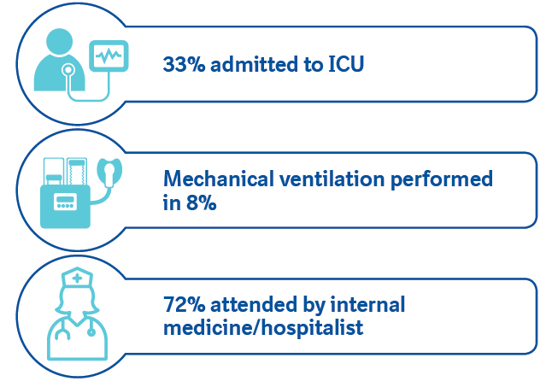
Study cohort
Cohort comprised 9667 hospitalized patients with IPF
Judy J et al. In-hospital mortality in patients with idiopathic pulmonary fibrosis. Poster developed for the American Thoracic Society International Conference, 2020.

Slide 7
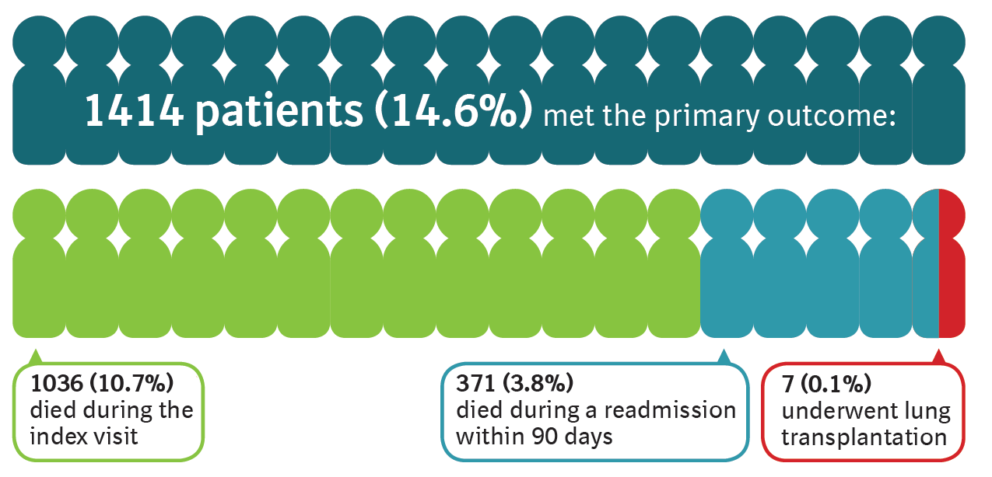
Primary outcome
Judy J et al. In-hospital mortality in patients with idiopathic pulmonary fibrosis. Poster developed for the American Thoracic Society International Conference, 2020.

Slide 8
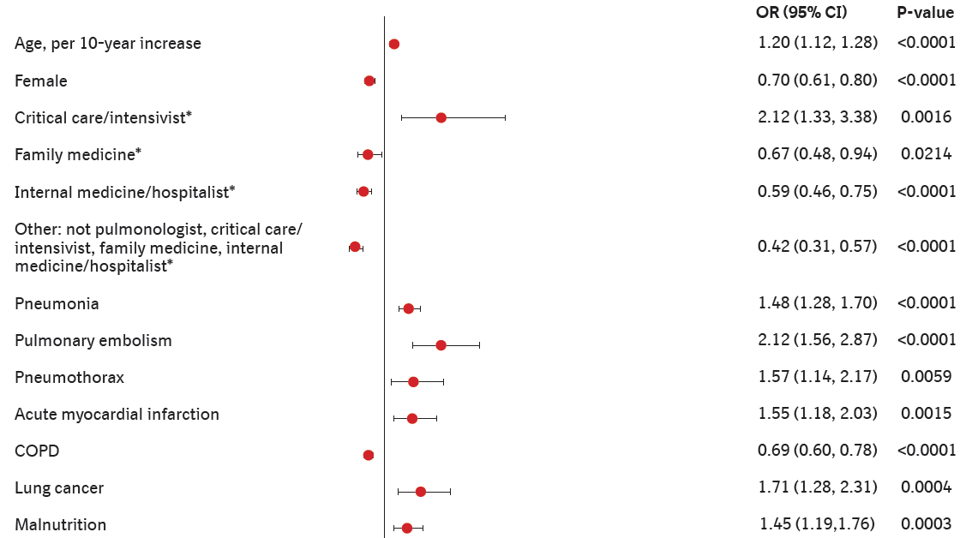
Factors associated with higher/lower risk of in-hospital mortality (1/2)
*Compared with pulmonologist. Analyzed using multivariable logistic regression.
Judy J et al. In-hospital mortality in patients with idiopathic pulmonary fibrosis. Poster developed for the American Thoracic Society International Conference, 2020.

Slide 9
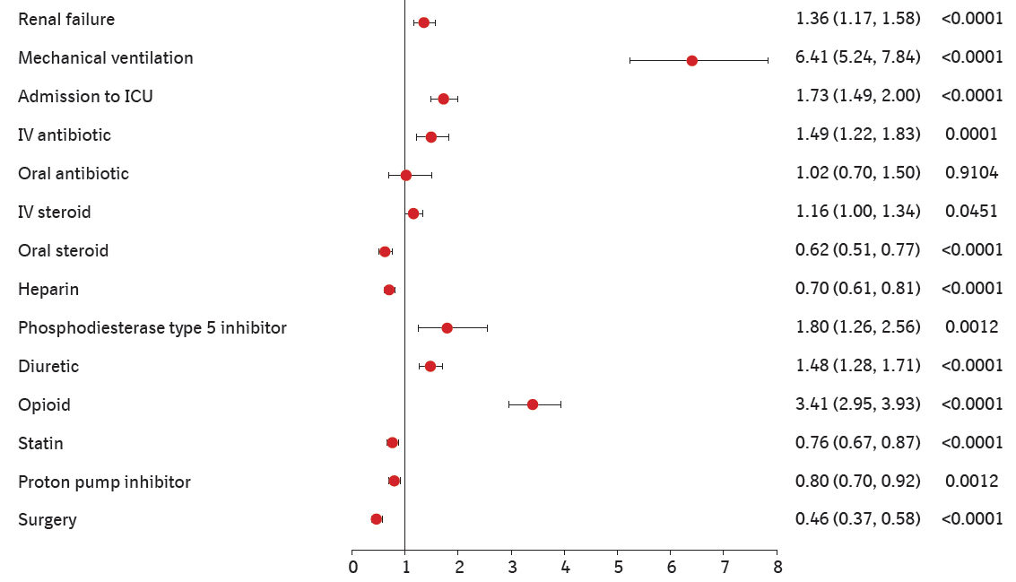
Factors associated with higher/lower risk of in-hospital mortality (2/2)
Analyzed using multivariable logistic regression.
Judy J et al. In-hospital mortality in patients with idiopathic pulmonary fibrosis. Poster developed for the American Thoracic Society International Conference, 2020.

Slide 10
Length of stay in hospital
Median (Q1, Q3) length of stay in hospital was 5 (3, 8) days:
7 (4, 13) days for patients who died in hospital
5 (3, 8) days for patients who did not
Judy J et al. In-hospital mortality in patients with idiopathic pulmonary fibrosis. Poster developed for the American Thoracic Society International Conference, 2020.

Slide 11
Factors estimated to increase length of stay in hospital
Analyzed using a generalized linear model with a negative binomial distribution.
Judy J et al. In-hospital mortality in patients with idiopathic pulmonary fibrosis. Poster developed for the American Thoracic Society International Conference, 2020.

Slide 12
Readmissions
Judy J et al. In-hospital mortality in patients with idiopathic pulmonary fibrosis. Poster developed for the American Thoracic Society International Conference, 2020.

Slide 13
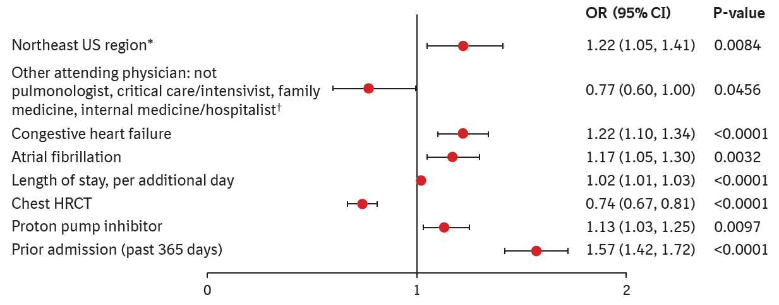
Factors associated with higher/lower risk of 90-day readmission
*Compared with south US region. †Compared with pulmonologist.
Analyzed using multivariable logistic regression.
Judy J et al. In-hospital mortality in patients with idiopathic pulmonary fibrosis. Poster developed for the American Thoracic Society International Conference, 2020.

Slide 14
Conclusions
In-hospital mortality rates and length of hospital stay among patients with IPF were similar in the eras prior to and following FDA approval of antifibrotic drugs
More than 1 in 10 patients died during the index hospitalization
Median length of hospital stay was 5 days
Risk of in-hospital mortality was higher in patients who:
were admitted to the ICU
were attended by a critical care physician
received mechanical ventilation
were treated with IV steroids, IV antibiotics, or opioids
Judy J et al. In-hospital mortality in patients with idiopathic pulmonary fibrosis. Poster developed for the American Thoracic Society International Conference, 2020.

Slide 15
Acknowledgements
This study was funded by Boehringer Ingelheim Pharmaceuticals, Inc (BIPI) as a collaboration with the Duke Clinical Research Institute and Premier, Inc.
Editorial and formatting assistance was provided by Julie Fleming and Wendy Morris of FleishmanHillard Fishburn, which was contracted and funded by BIPI. The authors meet criteria for authorship as recommended by the International Committee of Medical Journal Editors (ICMJE), received no direct compensation for the development of the poster, were fully responsible for all content and editorial decisions, were involved at all stages of development and have approved the final version. BI was given the opportunity to review the poster for medical and scientific accuracy as well as intellectual property considerations.

