Slide 1
Time to diagnosis of idiopathic pulmonary fibrosis in the IPF-PRO™ Registry
Snyder L et al. Time to diagnosis of idiopathic pulmonary fibrosis in the IPF-PRO™ Registry.
Poster developed for the American Thoracic Society International Conference, 2020.

Slide 2
Introduction
IPF is a progressive interstitial lung disease with a poor prognosis¹
Delays in the diagnosis of IPF have been reported,^{2–4} but patient characteristics associated with diagnostic delays are not well described
The Idiopathic Pulmonary Fibrosis Prospective Outcomes (IPF-PRO) Registry (NCT01915511) is an observational registry of patients with IPF involving over 40 sites across the US⁵
1. Raghu G et al. Am J Respir Crit Care Med 2018;198:e44–e68. 2. Hoyer N et al. Respir Res 2019;20:103. 3. Cottin V. Eur Respir Rev 2014;23:225–30. 4. Mooney J et al. Ann Am Thorac Soc 2019;16:393–6. 5. O’Brien EC et al. BMJ Open Respir Res 2016;3:e000108.
Snyder L et al. Time to diagnosis of idiopathic pulmonary fibrosis in the IPF-PRO Registry. Poster developed for the American Thoracic Society International Conference, 2020.

Slide 3
Aim
To investigate the time from symptom onset and from first imaging evidence of pulmonary fibrosis to diagnosis of IPF, and patient characteristics associated with a longer time to diagnosis
Snyder L et al. Time to diagnosis of idiopathic pulmonary fibrosis in the IPF-PRO Registry. Poster developed for the American Thoracic Society International Conference, 2020.

Slide 4
Methods
Data were analyzed from patients who:
Had been enrolled in the IPF-PRO Registry between 5 June 2014 and 11 March 2019
Had not been diagnosed with IPF prior to referral but received a new diagnosis of IPF at the enrolling center
Had a documented date in their medical records for symptom onset and/or HRCT scan showing pulmonary fibrosis
Patients were categorized as having a longer (>1 year) or shorter (≤1 year) time from symptom onset, and first imaging evidence of pulmonary fibrosis, to diagnosis of IPF
Patient characteristics at enrollment, and time from enrollment to death or lung transplant, were compared between patients with longer (>1 year) versus shorter (≤1 year) times to diagnosis of IPF
Snyder L et al. Time to diagnosis of idiopathic pulmonary fibrosis in the IPF-PRO Registry. Poster developed for the American Thoracic Society International Conference, 2020.

Slide 5
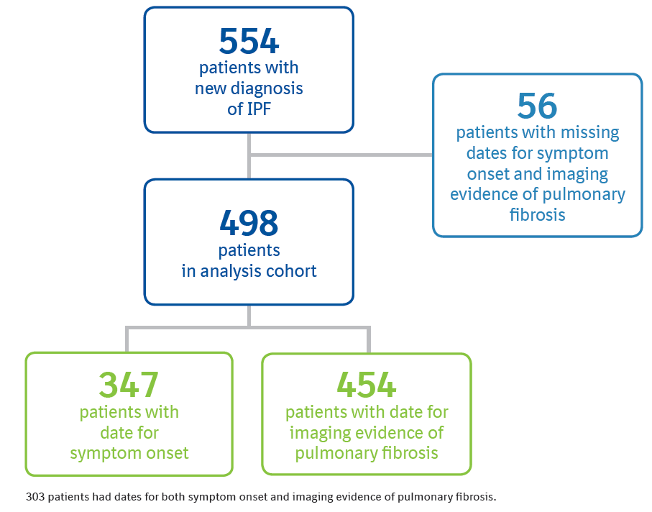
Patients
303 patients had dates for both symptom onset and imaging evidence of pulmonary fibrosis.
Snyder L et al. Time to diagnosis of idiopathic pulmonary fibrosis in the IPF-PRO Registry. Poster developed for the American Thoracic Society International Conference, 2020.

Slide 6
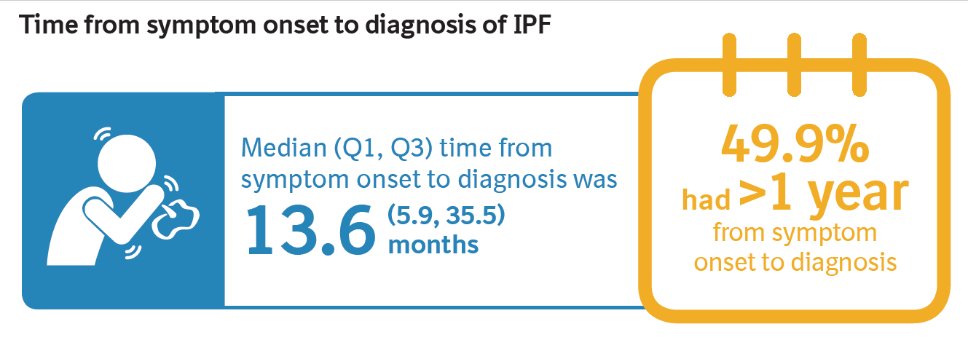
Time from symptom onset to diagnosis of IPF
Snyder L et al. Time to diagnosis of idiopathic pulmonary fibrosis in the IPF-PRO Registry. Poster developed for the American Thoracic Society International Conference, 2020.

Slide 7
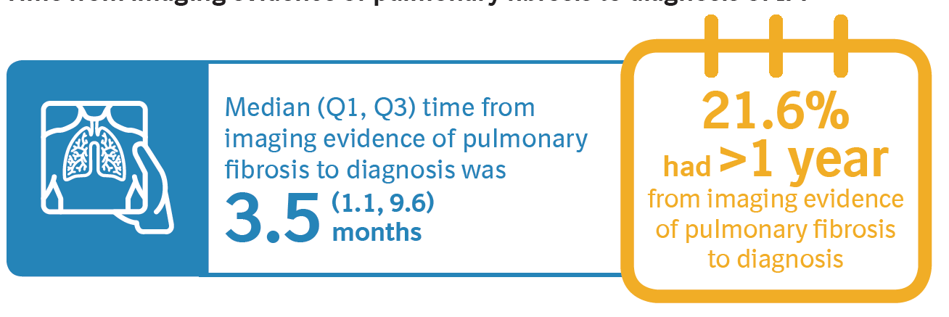
Time from imaging evidence of pulmonary fibrosis to diagnosis of IPF
Snyder L et al. Time to diagnosis of idiopathic pulmonary fibrosis in the IPF-PRO Registry. Poster developed for the American Thoracic Society International Conference, 2020.

Slide 8
Characteristics at enrollment among patients with a shorter or longer time to diagnosis of IPF
Time from symptom
onset to diagnosis
Time from imaging evidence of pulmonary fibrosis to diagnosis of IPF
≤1 year (n=174)
>1 year (n=173)
≤1 year (n=356)
>1 year (n=98)
FVC % predicted
67.4 (57.0, 79.8)
69.4 (57.2, 79.9)
70.7 (59.3, 80.8)
72.4 (60.1, 84.1)
DLco % predicted
41.8 (32.6, 50.8)
40.5 (31.8, 49.8)
43.7 (33.5, 52.7)
40.5 (32.1, 47.5)
Oxygen use at rest
22.4
25.6
18.4
21.1
Oxygen use with activity
31.8
39.2
29.5
30.2
Data are % or median (Q1, Q3).
Snyder L et al. Time to diagnosis of idiopathic pulmonary fibrosis in the IPF-PRO Registry. Poster developed for the American Thoracic Society International Conference, 2020.

Slide 9
Characteristics at enrollment among patients with a shorter or longer time to diagnosis of IPF: comorbidities (1/2)
Time from symptom
onset to diagnosis
Time from imaging evidence of pulmonary fibrosis to diagnosis of IPF
≤1 year (n=174)
>1 year (n=173)
≤1 year (n=356)
>1 year (n=98)
GERD
53.4
58.7
52.0
56.3
Coronary artery disease
24.7
31.4
30.7
33.3
Obstructive sleep apnea
27.2
32.2
29.1
26.0
Diabetes
23.0
21.5
18.0
29.9
Hiatial hernia
15.5
19.9
14.4
22.9
Atrial fibrillation or flutter
6.9
10.5
7.6
15.8
Data are %. GERD, gastroesophageal reflux disease.
Snyder L et al. Time to diagnosis of idiopathic pulmonary fibrosis in the IPF-PRO Registry. Poster developed for the American Thoracic Society International Conference, 2020.

Slide 10
Characteristics at enrollment among patients with a shorter or longer time to diagnosis of IPF: comorbidities (2/2)
Time from symptom
onset to diagnosis
Time from imaging evidence of pulmonary fibrosis to diagnosis of IPF
≤1 year (n=174)
>1 year (n=173)
≤1 year (n=356)
>1 year (n=98)
Congestive heart failure
5.8
5.2
7.4
8.3
Pulmonary hypertension
6.3
7.1
6.2
8.3
Prior DVT or pulmonary embolism
2.9
5.9
4.2
7.4
Prior stroke or intracranial hemorrhage
4.3
2.9
3.8
6.6
Barrett’s esophagus
3.4
2.3
1.7
5.2
Data are %. DVT, deep vein thrombosis.
Snyder L et al. Time to diagnosis of idiopathic pulmonary fibrosis in the IPF-PRO Registry. Poster developed for the American Thoracic Society International Conference, 2020.

Slide 11
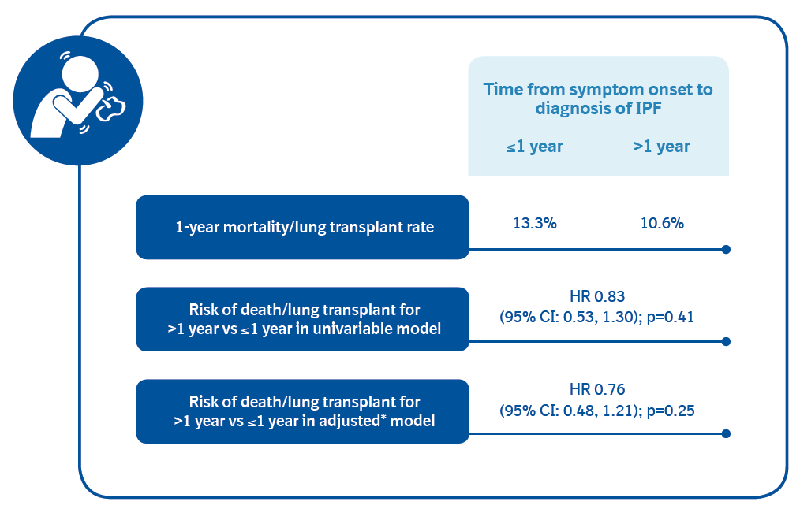
Time from enrollment to death or lung transplant (1/2)
Analyzed using a Cox proportional hazards models. *Adjusted model included variables previously identified as being associated with death or lung transplant in this registry (use of supplemental oxygen at rest or with activity, FVC % predicted, DLco % predicted) [Snyder L et al. Respir Res 2019;20:105] and age.
Snyder L et al. Time to diagnosis of idiopathic pulmonary fibrosis in the IPF-PRO Registry. Poster developed for the American Thoracic Society International Conference, 2020.

Slide 12
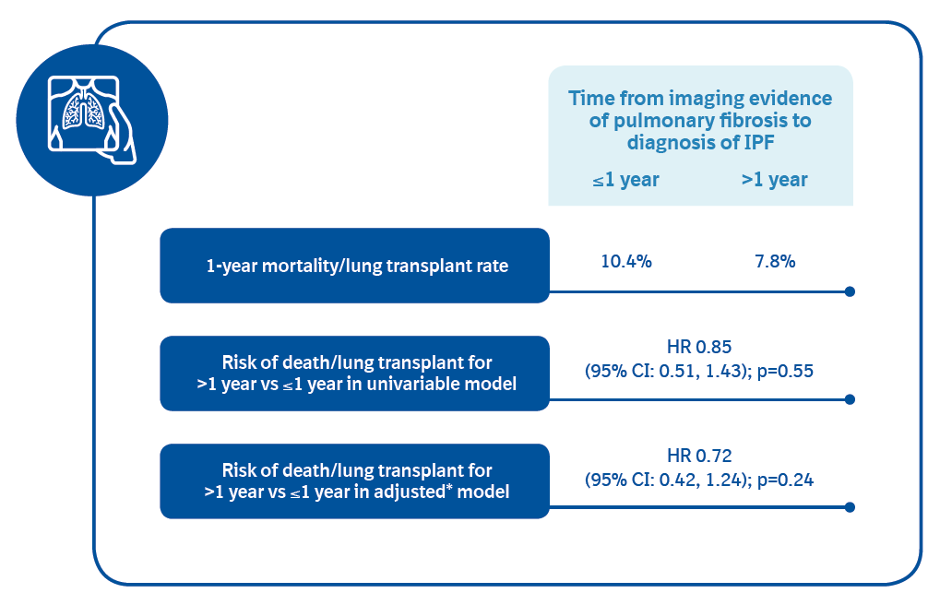
Time from enrollment to death or lung transplant (2/2)
Analyzed using a Cox proportional hazards models. *Adjusted model included variables previously identified as being associated with death or lung transplant in this registry (use of supplemental oxygen at rest or with activity, FVC % predicted, DLco % predicted) [Snyder L et al. Respir Res 2019;20:105] and age.
Snyder L et al. Time to diagnosis of idiopathic pulmonary fibrosis in the IPF-PRO Registry. Poster developed for the American Thoracic Society International Conference, 2020.

Slide 13
Among patients who received their first diagnosis of IPF at an enrolling center in the IPF-PRO Registry:
Approximately 50% had a delay of >1 year between symptom onset and diagnosis of IPF
Approximately 80% were diagnosed with IPF within 1 year of imaging evidence of pulmonary fibrosis
Cardiac conditions were more frequent in patients with a time to diagnosis >1 year than ≤1 year
Despite improved awareness of IPF, there remains a long period from symptom onset to diagnosis in a large proportion of patients. Getting an HRCT scan performed is a critical step in the diagnostic process.
Snyder L et al. Time to diagnosis of idiopathic pulmonary fibrosis in the IPF-PRO Registry. Poster developed for the American Thoracic Society International Conference, 2020.

Slide 14
Acknowledgements
The IPF-PRO Registry is funded by Boehringer Ingelheim Pharmaceuticals, Inc (BIPI) and coordinated by the Duke Clinical Research Institute.
Editorial and formatting assistance, supported financially by BIPI, were provided by Julie Fleming and Wendy Morris of FleishmanHillard Fishburn, London, UK during preparation of these slides and the poster on which these slides were based. The authors meet criteria for authorship as recommended by the International Committee of Medical Journal Editors (ICMJE), received no direct compensation for the development of the poster, were fully responsible for all content and editorial decisions, were involved at all stages of development and have approved the final version. BI was given the opportunity to review the poster for medical and scientific accuracy as well as intellectual property considerations.

Slide 15
IPF-PRO Registry enrolling centers
Albany Medical Center, Albany, NY; Baylor College of Medicine, Houston, TX; Baylor University Medical Center at Dallas, Dallas, TX; Cleveland Clinic, Cleveland, OH; Columbia University Medical Center/New York Presbyterian Hospital, New York, NY; Duke University Medical Center, Durham, NC; Froedtert & The Medical College of Wisconsin Community Physicians, Milwaukee, WI; Houston Methodist Lung Center, Houston, TX; Lahey Clinic, Burlington, MA; Loyola University Health System, Maywood, IL; Lynchburg Pulmonary Associates, Lynchburg, VA; Medical University of South Carolina, Charleston, SC; National Jewish Health, Denver, CO; NYU Medical Center, New York, NY; Piedmont Healthcare, Austell, GA; Pulmonary Associates of Stamford, Stamford, CT; PulmonIx LLC, Greensboro, NC; Renovatio Clinical, The Woodlands, TX; Salem Chest and Southeastern Clinical Research Center, Winston Salem, NC; South Miami Hospital, South Miami, FL; St. Joseph’s Hospital, Phoenix, AZ; Stanford University, Stanford, CA; Temple University, Philadelphia, PA; The Oregon Clinic, Portland, OR; Tulane University, New Orleans, LA; UNC Chapel Hill, Chapel Hill, NC; University of Alabama at Birmingham, Birmingham, AL; University of California, Davis, Sacramento, CA; University of California Los Angeles, Los Angeles, CA; University of Chicago, Chicago, IL; University of Cincinnati Medical Center, Cincinnati, OH; University of Louisville, Louisville, KY; University of Miami, Miami, FL; University of Michigan, Ann Arbor, MI; University of Minnesota, Minneapolis, MN; University of Pennsylvania, Philadelphia, PA; University of Pittsburgh, Pittsburgh, PA; University of Virginia, Charlottesville, VA; UT Southwestern Medical Center, Dallas, TX; Vanderbilt University Medical Center, Nashville, TN; Vermont Lung Center, Colchester, VT; Wake Forest University, Winston Salem, NC; Washington University, St. Louis, MO; Weill Cornell Medical College, New York, NY; Wilmington Health and PMG Research, Wilmington, NC; Yale School of Medicine, New Haven, CT.

