Slide 1
Effects of nintedanib on dyspnea, cough and quality of life in patients with progressive fibrosing interstitial lung diseases (ILDs): findings from the INBUILD® trial
Swigris JJ et al. Effects of nintedanib on dyspnea, cough and quality of life in patients with progressive fibrosing interstitial lung diseases (ILDs): findings from the INBUILD trial. Poster developed for the American Thoracic Society International Conference, 2020.

Slide 2
Introduction
Dyspnea, cough and fatigue can affect the emotional and physical well-being of patients with fibrosing ILDs¹
In the INBUILD trial in patients with chronic fibrosing ILDs and a progressive phenotype (other than IPF):
nintedanib slowed the rate of decline in FVC versus placebo, with adverse events that were manageable for most patients²
changes in HRQL measured using the King’s Brief Interstitial Lung Disease (K-BILD) questionnaire were small, with no meaningful difference between treatment groups²
other novel questionnaires were used to assess changes in symptoms and HRQL
IPF, idiopathic pulmonary fibrosis. HRQL, health-related quality of life.
1. Swigris JJ et al. Eur Respir Rev 2018;27(150). 2. Flaherty KR et al. N Engl J Med 2019;381:1718–27. Swigris JJ et al. Effects of nintedanib on dyspnea, cough and quality of life in patients with progressive fibrosing interstitial lung diseases (ILDs): findings from the INBUILD trial.
Poster developed for the American Thoracic Society International Conference, 2020.

Slide 3
Aim
To assess the effects of nintedanib on symptoms and HRQL in the INBUILD trial using the Living with Pulmonary Fibrosis (L-PF) questionnaire and the Pulmonary Fibrosis Impact on Quality of Life Scale (PF-IQOLS)
Swigris JJ et al. Effects of nintedanib on dyspnea, cough and quality of life in patients with progressive fibrosing interstitial lung diseases (ILDs): findings from the INBUILD trial.
Poster developed for the American Thoracic Society International Conference, 2020.

Slide 4
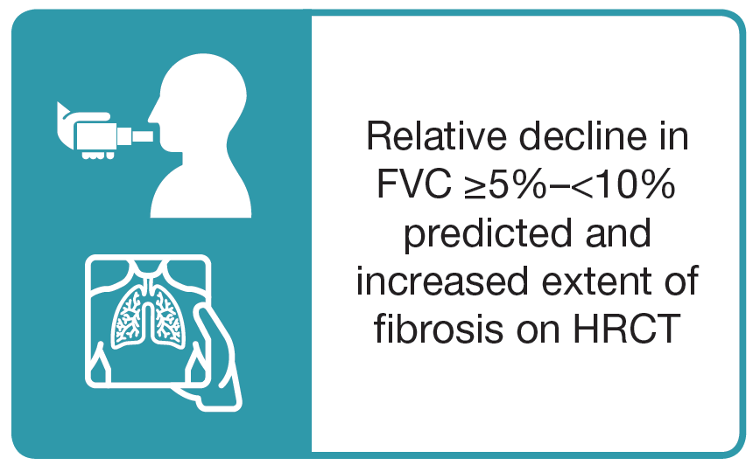
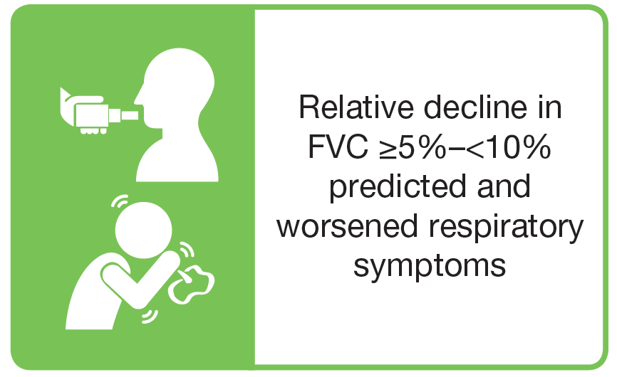
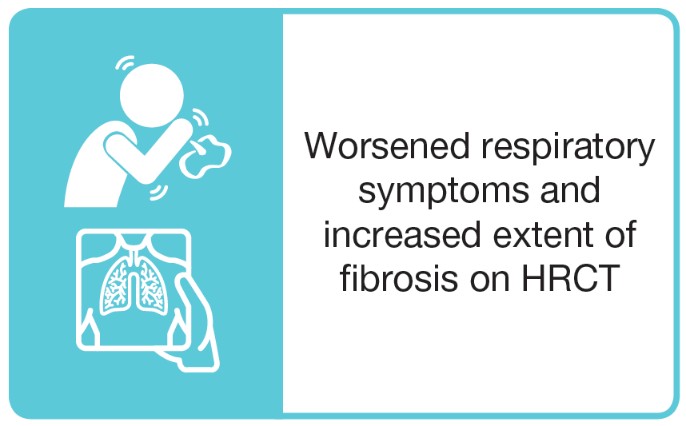
Trial design
Subjects had an ILD other than IPF, reticular abnormality with traction bronchiectasis (with or without honeycombing) of >10% extent on HRCT, FVC ≥45% predicted and DLco ≥30%–<80% predicted
Subjects met ≥1 of the following criteria for ILD progression in the 24 months before screening, despite management as deemed appropriate in clinical practice:
Subjects were randomized 1:1 to receive nintedanib or placebo, stratified by HRCT pattern (UIP-like fibrotic pattern or other fibrotic patterns)
The L-PF questionnaire and PF-IQOLS were completed at baseline and week 52
UIP, usual interstitial pneumonia. Swigris JJ et al. Effects of nintedanib on dyspnea, cough and quality of life in patients with progressive fibrosing interstitial lung diseases (ILDs): findings from the INBUILD trial.
Poster developed for the American Thoracic Society International Conference, 2020.

Slide 5
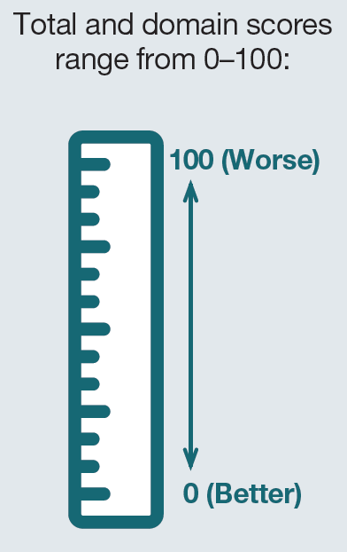
Living with Pulmonary Fibrosis (L-PF) questionnaire
Assesses health status in patients with pulmonary fibrosis
44-item questionnaire with two modules:
The symptoms module has three domains:
Symptoms and impacts scores are used to calculate a total score
Swigris JJ et al. Effects of nintedanib on dyspnea, cough and quality of life in patients with progressive fibrosing interstitial lung diseases (ILDs): findings from the INBUILD trial.
Poster developed for the American Thoracic Society International Conference, 2020.

Slide 6
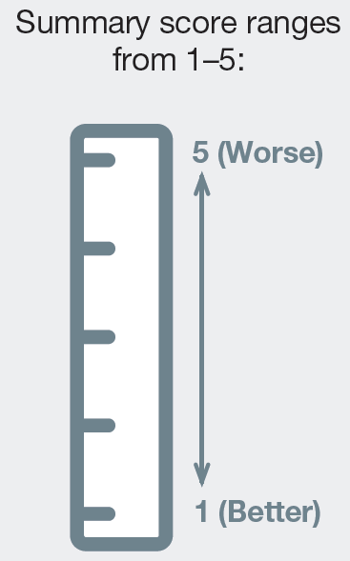
Pulmonary Fibrosis Impact on Quality of Life Scale (PF-IQOLS)
Assesses the impact of pulmonary fibrosis on domains including:
material and physical
well-being
relationships
work, social, community and civic activities
recreation
independence
Questionnaire comprises 16 domains, each with 5-point response scale
The summary score is the mean of the domain ratings
Burckhardt CS et al. Res Nurs Health 1989;12:347–54. Flanagan JC. Am Psychol 1978;33:138–47. Swigris JJ et al. Effects of nintedanib on dyspnea, cough and quality of life in patients with progressive fibrosing interstitial lung diseases (ILDs): findings from the INBUILD trial.
Poster developed for the American Thoracic Society International Conference, 2020.

Slide 7
Analyses
In pre-specified analyses, we assessed changes from baseline at week 52 in the L-PF total score, impact score, symptoms score and symptoms domain scores, and the PF-IQOLS summary score
Changes in the L-PF symptoms dyspnea domain score and the L-PF symptoms cough domain score were secondary endpoints
Changes in all other scores were further endpoints
Data were analyzed using a mixed model for repeated measures, with fixed effects for baseline, HRCT pattern, visit, treatment-by-visit interaction, baseline-by-visit interaction and random effect for subject
Swigris JJ et al. Effects of nintedanib on dyspnea, cough and quality of life in patients with progressive fibrosing interstitial lung diseases (ILDs): findings from the INBUILD trial.
Poster developed for the American Thoracic Society International Conference, 2020.

Slide 8
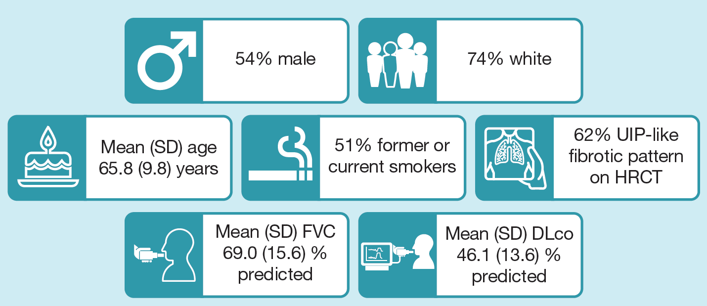
Baseline characteristics
Swigris JJ et al. Effects of nintedanib on dyspnea, cough and quality of life in patients with progressive fibrosing interstitial lung diseases (ILDs): findings from the INBUILD trial.
Poster developed for the American Thoracic Society International Conference, 2020.

Slide 9
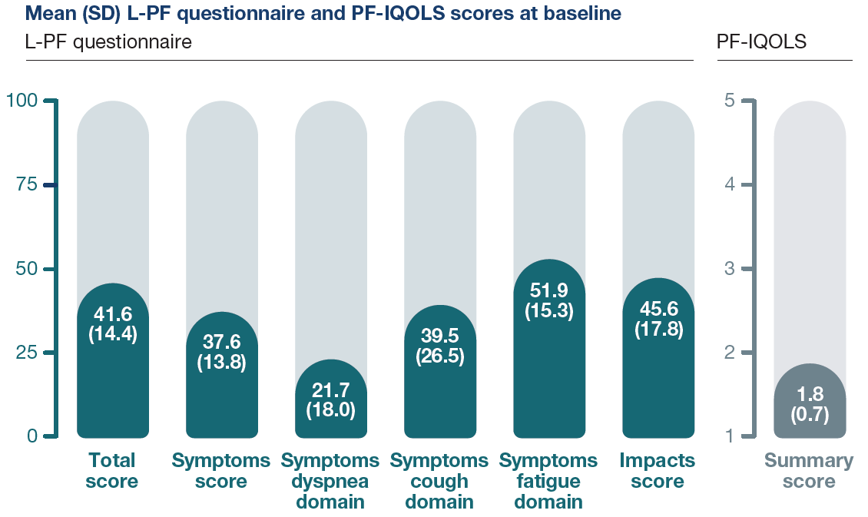
L-PF questionnaire and PF-IQOLS scores at baseline
Data are mean (SD). Higher scores represent worse health status. Swigris JJ et al. Effects of nintedanib on dyspnea, cough and quality of life in patients with progressive fibrosing interstitial lung diseases (ILDs): findings from the INBUILD trial.
Poster developed for the American Thoracic Society International Conference, 2020.

Slide 10
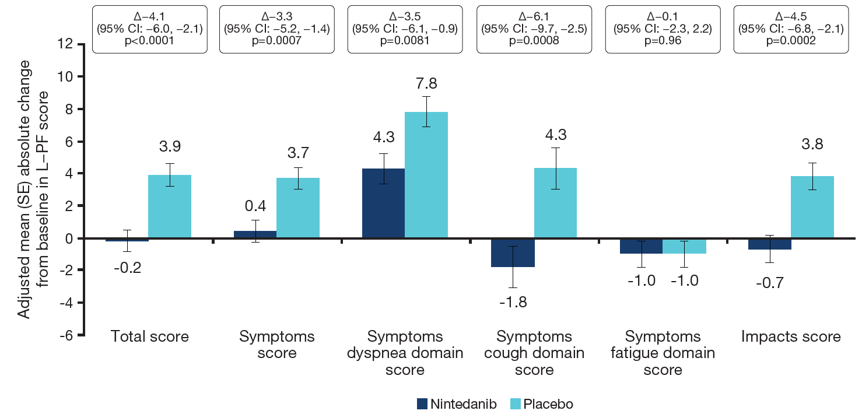
Changes from baseline in L-PF questionnaire scores at week 52
Higher scores represent worse health status. Swigris JJ et al. Effects of nintedanib on dyspnea, cough and quality of life in patients with progressive fibrosing interstitial lung diseases (ILDs): findings from the INBUILD trial.
Poster developed for the American Thoracic Society International Conference, 2020.

Slide 11
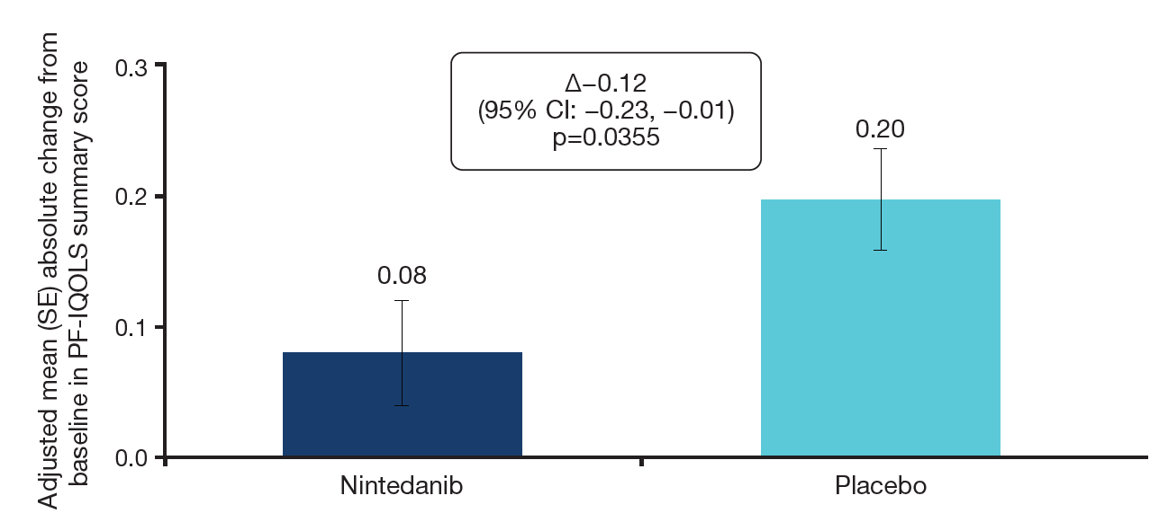
Change from baseline in PF-IQOLS summary score at week 52
Higher scores represent worse health status. Swigris JJ et al. Effects of nintedanib on dyspnea, cough and quality of life in patients with progressive fibrosing interstitial lung diseases (ILDs): findings from the INBUILD trial.
Poster developed for the American Thoracic Society International Conference, 2020.

Slide 12
Conclusions
In the INBUILD trial in patients with chronic fibrosing ILDs and a progressive phenotype:
Changes in scores on the L-PF questionnaire suggested that nintedanib may prevent worsening of cough and reduce worsening of dyspnea over 52 weeks
Change in the PF-IQOLS summary score suggested that nintedanib may reduce worsening of HRQL over 52 weeks
Further data are needed on the validation of these patient-reported outcomes and on minimum clinically important differences in this patient population
Swigris JJ et al. Effects of nintedanib on dyspnea, cough and quality of life in patients with progressive fibrosing interstitial lung diseases (ILDs): findings from the INBUILD trial.
Poster developed for the American Thoracic Society International Conference, 2020.

Slide 13
Acknowledgements
The INBUILD trial was funded by Boehringer Ingelheim
Editorial and formatting assistance, supported financially by Boehringer Ingelheim, was provided by Julie Fleming and Wendy Morris of FleishmanHillard Fishburn, London, UK, during preparation of the poster on which these slides were based. The authors were fully responsible for all content and editorial decisions, were involved at all stages of poster development and have approved the final version. The authors received no direct compensation related to the development of the poster or slides. Boehringer Ingelheim was given the opportunity to review the poster for medical and scientific accuracy as well as intellectual property considerations

