Slide 1
Association of circulating proteins with death or lung transplant in the IPF-PRO™ Registry cohort
Todd JL et al. Association of circulating proteins with death or lung transplant in the IPF-PRO™ Registry cohort. Poster developed for the American Thoracic Society International Conference, 2020.

Slide 2
Introduction
IPF is a progressive fibrosing interstitial lung disease with an unpredictable clinical course
There is an unmet need for biomarkers that predict clinically relevant outcomes in patients with IPF
Patients with IPF have a unique peripheral blood proteome,^{1,2} thus proteomic profiling may identify targets for development of prognostic biomarkers
1. O’Dwyer DN et al. Sci Rep 2017;7:46560; 2. Todd JL et al. Respir Res 2019;20:227.
Todd JL et al. Association of circulating proteins with death or lung transplant in the IPF-PRO Registry cohort. Poster developed for the American Thoracic Society International Conference, 2020.

Slide 3
Aim
To examine the association between circulating proteins and respiratory death or lung transplant in patients with IPF
Todd JL et al. Association of circulating proteins with death or lung transplant in the IPF-PRO Registry cohort. Poster developed for the American Thoracic Society International Conference, 2020.

Slide 4
Study cohort
The cohort was drawn from the Idiopathic Pulmonary Fibrosis Prospective Outcomes (IPF-PRO) Registry, a multicenter US registry that enrolled patients with IPF that was diagnosed or confirmed at the enrolling center in the past 6 months¹
These analyses were based on data from 300 patients enrolled between March 2016 and February 2017
Outcomes were ascertained from enrollment to June 2019
1. O’Brien EC et al. BMJ Open Respir Res 2016;3:e000108.
Todd JL et al. Association of circulating proteins with death or lung transplant in the IPF-PRO Registry cohort. Poster developed for the American Thoracic Society International Conference, 2020.

Slide 5
Proteomic assays
Plasma samples taken at enrollment were assayed using an aptamer-based platform encompassing 1305 proteins
Protein data were log₂ transformed prior to analysis
Todd JL et al. Association of circulating proteins with death or lung transplant in the IPF-PRO Registry cohort. Poster developed for the American Thoracic Society International Conference, 2020.

Slide 6
Univariable analyses
Determined the univariable association between each protein and the composite outcome of respiratory death or lung transplant
Analyzed using Cox proportional hazards modelling
Linearity and proportional hazards assumptions associated with the unadjusted model were assessed prior to fitting each model
Analyses were adjusted for sex, age, FVC % predicted, DLco % predicted, oxygen use at rest, oxygen use with activity (all assessed at enrollment)
P-values were corrected for multiple comparisons using the Benjamini-Hochberg method to control the false discovery rate (FDR) at 5%
Todd JL et al. Association of circulating proteins with death or lung transplant in the IPF-PRO Registry cohort. Poster developed for the American Thoracic Society International Conference, 2020.

Slide 7
Multivariable analyses
Determined a set of candidate predictors for the composite outcome of respiratory death or lung transplant
Analyzed using Cox regression modelling with the elastic net penalty, considering
proteins only
proteins and clinical factors (sex, age, FVC % predicted, DLco % predicted, oxygen use at rest, oxygen use with activity [all assessed at enrollment])
Model performance was assessed by Harrell’s C-index, corrected for optimism
Todd JL et al. Association of circulating proteins with death or lung transplant in the IPF-PRO Registry cohort. Poster developed for the American Thoracic Society International Conference, 2020.

Slide 8
Patient characteristics at enrollment (n=300)
Age (years) | 70 (65, 75)
Male | 223 (74%)
White | 281 (94%)
Smoking
Past | 202 (67%)
Never | 96 (32%)
Current | 2 (1%)
FVC % predicted | 69.7 (61.0, 80.2)
DLco % predicted | 40.5 (31.1, 49.3)
Antifibrotic drug use
Pirfenidone | 106 (35%)
Nintedanib | 56 (19%)
Neither | 138 (46%)
Values are median (Q1, Q3) or n (%).
Todd JL et al. Association of circulating proteins with death or lung transplant in the IPF-PRO Registry cohort. Poster developed for the American Thoracic Society International Conference, 2020.

Slide 9
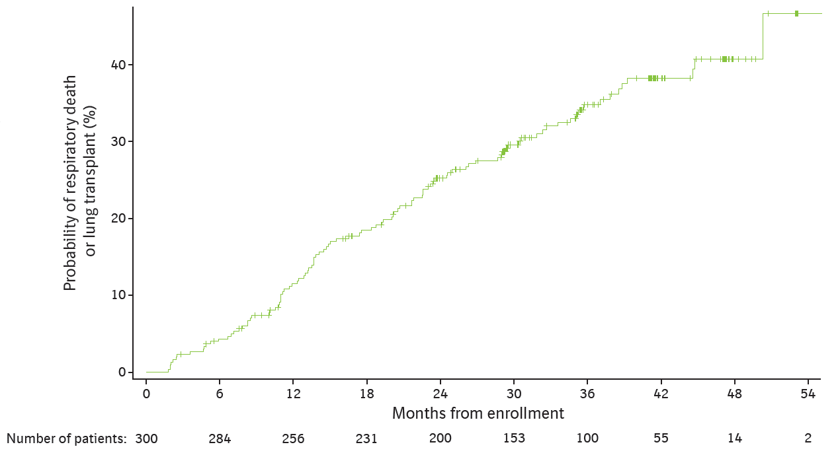
Respiratory death or lung transplant
Median (Q1, Q3) follow-up was 30.4 (20.1, 41.1) months
76 respiratory deaths and 26 lung transplants occurred during follow-up
Todd JL et al. Association of circulating proteins with death or lung transplant in the IPF-PRO Registry cohort. Poster developed for the American Thoracic Society International Conference, 2020.

Slide 10
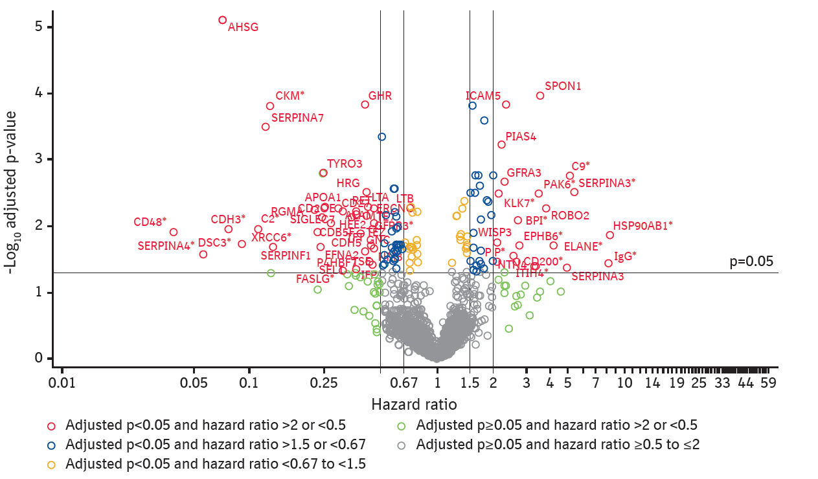
Univariable association between each protein and composite of respiratory death or lung transplant
Unadjusted analyses
In unadjusted analyses, 61 proteins were significantly associated† with the composite of respiratory death or lung transplant
After adjustment for clinical factors, 22 proteins were significantly associated† with the composite of respiratory death or lung transplant
†Hazard ratio >2 or <0.5 and adjusted p<0.05.
*Analyte failed linearity or proportional hazards assumption. For analytes that failed the linearity assumption, the hazard ratio associated with the maximum relative effect from 2-3 piece-wise linear (PWL) components used to represent this analyte is shown. For analytes that failed the proportional hazards assumption, the time-dependent hazard ratio associated with the maximum relative effect at 12, 24, or 36 months is shown. For analytes that failed both, the maximum hazard ratio associated with PWL components at 12, 24, or 36 months is shown.
Todd JL et al. Association of circulating proteins with death or lung transplant in the IPF-PRO Registry cohort. Poster developed for the American Thoracic Society International Conference, 2020.

Slide 11
Multivariable analyses of predictors of respiratory death or lung transplant: model performance metrics
In analyses considering proteins only,
a set of 55 proteins predicted the probability of respiratory death or lung transplant with a C-index* of 0.76
In analyses considering proteins and clinical factors†, a set of 56 predictors (52 proteins, 4 clinical)
were selected with a C-index* of 0.77
*Corrected for optimism. †Sex, age, FVC % predicted, DLco % predicted, oxygen use at rest, oxygen use with activity (all assessed at enrollment).
Todd JL et al. Association of circulating proteins with death or lung transplant in the IPF-PRO Registry cohort. Poster developed for the American Thoracic Society International Conference, 2020.

Slide 12
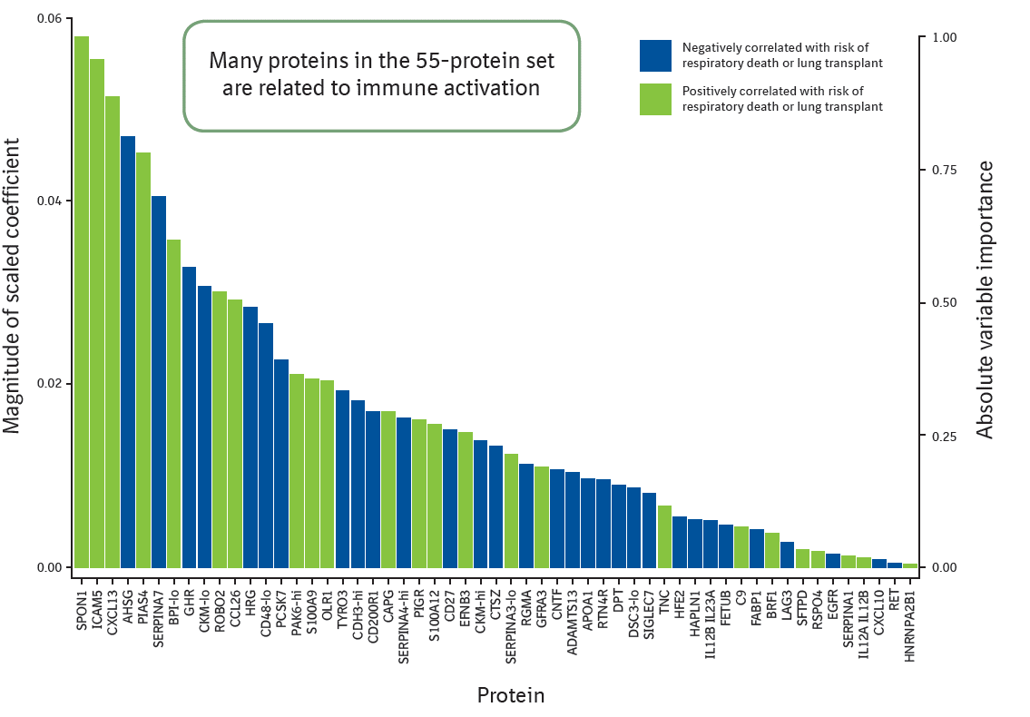
Variable importance of predictors of respiratory death or lung transplant: model considering proteins only
Many proteins in the 55-protein set are related to immune activation
Todd JL et al. Association of circulating proteins with death or lung transplant in the IPF-PRO Registry cohort. Poster developed for the American Thoracic Society International Conference, 2020.

Slide 13
Variable importance of predictors of respiratory death or lung transplant: model considering proteins and clinical factors
Selected clinical factors were oxygen use at rest, oxygen use with activity, DLco % predicted, FVC % predicted
Only oxygen use had greater importance than proteins in predicting the composite outcome
Todd JL et al. Association of circulating proteins with death or lung transplant in the IPF-PRO Registry cohort. Poster developed for the American Thoracic Society International Conference, 2020.

Slide 14
In a cross-sectional analysis of 300 patients with IPF, select circulating proteins strongly associated with respiratory death or lung transplant, even after considering clinical factors known to influence outcomes
We report a protein signature for predicting respiratory death or lung transplant in patients with IPF that can be evaluated in a validation cohort
Important considerations for validation studies will include the method of protein measurement (aptamer vs ELISA) and exposure to antifibrotic drugs
ELISA, enzyme-linked immunosorbent assay.

Slide 15
Acknowledgements
The IPF-PRO Registry is funded by Boehringer Ingelheim Pharmaceuticals, Inc (BIPI) and coordinated by the Duke Clinical Research Institute.
Editorial and formatting assistance was provided by Elizabeth Ng and Wendy Morris of FleishmanHillard Fishburn, which was contracted and funded by BIPI. The authors meet criteria for authorship as recommended by the International Committee of Medical Journal Editors (ICMJE), received no direct compensation for the development of the poster, were fully responsible for all content and editorial decisions, were involved at all stages of development and have approved the final version. BI was given the opportunity to review the poster for medical and scientific accuracy as well as intellectual property considerations.

Slide 16
IPF-PRO Registry enrolling centers
Albany Medical Center, Albany, NY; Baylor College of Medicine, Houston, TX; Baylor University Medical Center at Dallas, Dallas, TX; Cleveland Clinic, Cleveland, OH; Columbia University Medical Center/New York Presbyterian Hospital, New York, NY; Duke University Medical Center, Durham, NC; Froedtert & The Medical College of Wisconsin Community Physicians, Milwaukee, WI; Houston Methodist Lung Center, Houston, TX; Lahey Clinic, Burlington, MA; Loyola University Health System, Maywood, IL; Lynchburg Pulmonary Associates, Lynchburg, VA; Medical University of South Carolina, Charleston, SC; National Jewish Health, Denver, CO; NYU Medical Center, New York, NY; Piedmont Healthcare, Austell, GA; Pulmonary Associates of Stamford, Stamford, CT; PulmonIx LLC, Greensboro, NC; Renovatio Clinical, The Woodlands, TX; Salem Chest and Southeastern Clinical Research Center, Winston Salem, NC; South Miami Hospital, South Miami, FL; St. Joseph’s Hospital, Phoenix, AZ; Stanford University, Stanford, CA; Temple University, Philadelphia, PA; The Oregon Clinic, Portland, OR; Tulane University, New Orleans, LA; UNC Chapel Hill, Chapel Hill, NC; University of Alabama at Birmingham, Birmingham, AL; University of California, Davis, Sacramento, CA; University of California Los Angeles, Los Angeles, CA; University of Chicago, Chicago, IL; University of Cincinnati Medical Center, Cincinnati, OH; University of Louisville, Louisville, KY; University of Miami, Miami, FL; University of Michigan, Ann Arbor, MI; University of Minnesota, Minneapolis, MN; University of Pennsylvania, Philadelphia, PA; University of Pittsburgh, Pittsburgh, PA; University of Virginia, Charlottesville, VA; UT Southwestern Medical Center, Dallas, TX; Vanderbilt University Medical Center, Nashville, TN; Vermont Lung Center, Colchester, VT; Wake Forest University, Winston Salem, NC; Washington University, St. Louis, MO; Weill Cornell Medical College, New York, NY; Wilmington Health and PMG Research, Wilmington, NC; Yale School of Medicine, New Haven, CT.

