Slide 1
Efficacy and safety of nintedanib in patients with idiopathic pulmonary fibrosis (IPF): subgroup analyses by TORVAN stage
Torrisi SE et al. Efficacy and safety of nintedanib in patients with idiopathic pulmonary fibrosis (IPF): subgroup analyses by TORVAN stage. Poster developed for the American Thoracic Society International Conference, 2020.

Slide 2
Introduction
IPF is a progressive fibrosing ILD characterized by loss of lung function and early mortality¹
Patients with IPF frequently have comorbidities that affect survival^{2,3}
The TORVAN index and staging system was developed to predict mortality in patients with IPF based on age, FVC, Dlco, and common comorbidities³
1. Kreuter M et al. PLoS One 2016:11:e0151425; 2. Torrisi SE et al. Eur Respir J 2019;53 pii: 1801587.
Torrisi SE et al. Efficacy and safety of nintedanib in patients with idiopathic pulmonary fibrosis (IPF): subgroup analyses by TORVAN stage. Poster developed for the American Thoracic Society International Conference, 2020.

Slide 3
Aim
To assess the efficacy and safety of nintedanib in patients with IPF at different TORVAN stages
Torrisi SE et al. Efficacy and safety of nintedanib in patients with idiopathic pulmonary fibrosis (IPF): subgroup analyses by TORVAN stage. Poster developed for the American Thoracic Society International Conference, 2020.

Slide 4
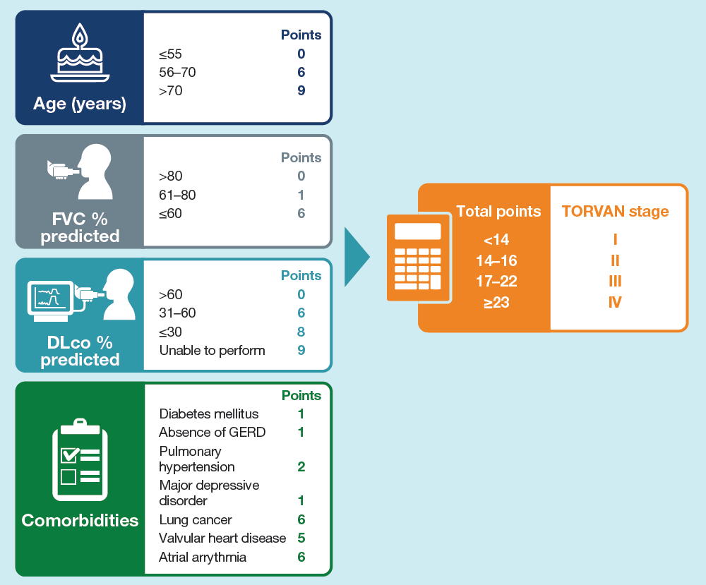
Methods
Calculation of TORVAN stage³
Data were pooled from three placebo-controlled trials of nintedanib: the TOMORROW trial¹ and the two INPULSIS trials²
Points were assigned to age, FVC % predicted, DLco % predicted, and certain comorbidities at baseline to generate a total score that classified patients as at TORVAN stage I, II, III, or IV:
1. Richeldi L et al. N Engl J Med 2011;365:1079–87; 2. Richeldi L et al. N Engl J Med 2014;370:2071–82; 3. Torrisi SE et al. Eur Respir J 2019;53 pii: 1801587.
Torrisi SE et al. Efficacy and safety of nintedanib in patients with idiopathic pulmonary fibrosis (IPF): subgroup analyses by TORVAN stage. Poster developed for the American Thoracic Society International Conference, 2020.

Slide 5
Analyses
In post-hoc analyses, we analyzed the following over 52 weeks in subgroups by TORVAN stage (I, II, or III/IV) at baseline:
Rate of decline in FVC (mL/year)
Time to disease progression (absolute decline in FVC ≥10% predicted or death)
Time to first investigator-reported acute exacerbation
Change in St. George’s Respiratory Questionnaire (SGRQ) total score (a measure of health-related quality of life)
Interaction p-values were calculated to assess potential heterogeneity in the treatment effect of nintedanib versus placebo across the subgroups. No adjustment for multiplicity was made
Adverse events are presented descriptively
Torrisi SE et al. Efficacy and safety of nintedanib in patients with idiopathic pulmonary fibrosis (IPF): subgroup analyses by TORVAN stage. Poster developed for the American Thoracic Society International Conference, 2020.

Slide 6
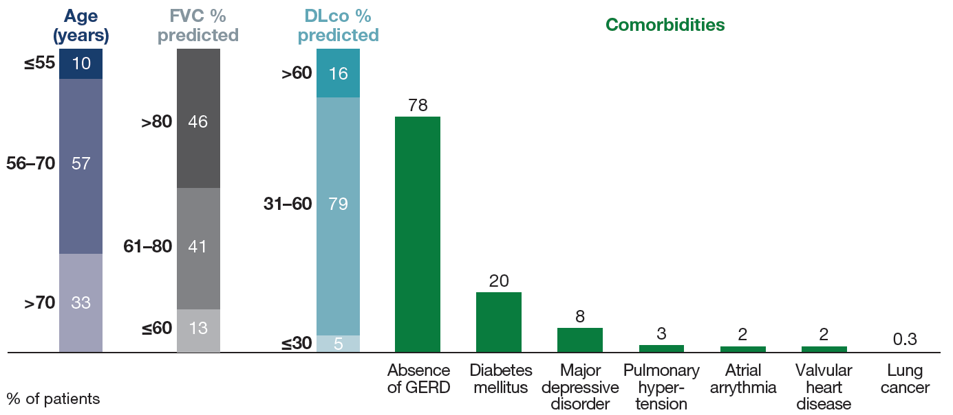
Proportions of patients in age, FVC and DLco ranges and with comorbidities used to calculate TORVAN stage
Torrisi SE et al. Efficacy and safety of nintedanib in patients with idiopathic pulmonary fibrosis (IPF): subgroup analyses by TORVAN stage. Poster developed for the American Thoracic Society International Conference, 2020.

Slide 7
Proportions of patients at TORVAN stages I, II, and III/IV
Torrisi SE et al. Efficacy and safety of nintedanib in patients with idiopathic pulmonary fibrosis (IPF): subgroup analyses by TORVAN stage. Poster developed for the American Thoracic Society International Conference, 2020.

Slide 8
Baseline characteristics by TORVAN stage
Mean or % of patients.
Torrisi SE et al. Efficacy and safety of nintedanib in patients with idiopathic pulmonary fibrosis (IPF): subgroup analyses by TORVAN stage. Poster developed for the American Thoracic Society International Conference, 2020.

Slide 9
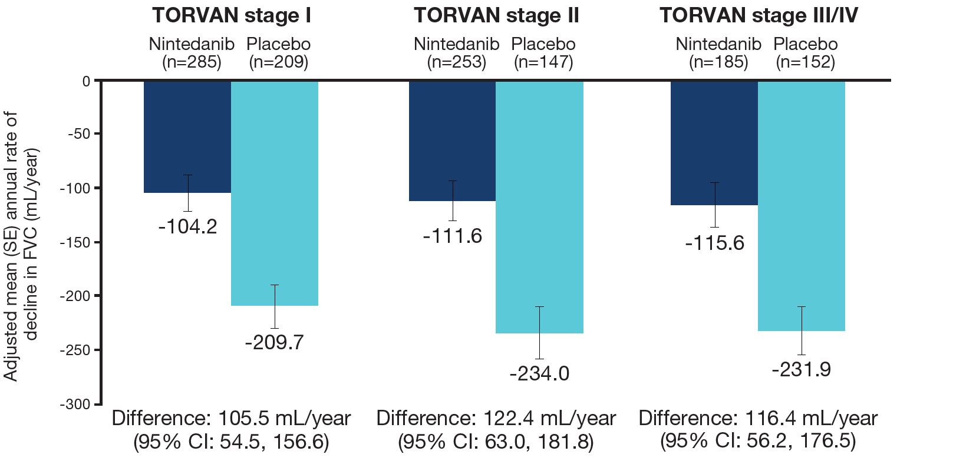
Annual rate of decline in FVC (mL/year)
Treatment-by-time-by-subgroup interaction p=0.92.
Torrisi SE et al. Efficacy and safety of nintedanib in patients with idiopathic pulmonary fibrosis (IPF): subgroup analyses by TORVAN stage. Poster developed for the American Thoracic Society International Conference, 2020.

Slide 10
Time to disease progression (absolute decline in FVC ≥10% predicted or death) over 52 weeks
 | TORVAN stage I |  | TORVAN stage II |  | TORVAN stage III/IV
 | Nintedanib (n=285) | Placebo (n=209) | Nintedanib (n=253) | Placebo (n=147) | Nintedanib (n=185) | Placebo (n=152)
Patients with disease progression, n (%) | 74 (26.0) | 80 (38.3) | 73 (28.9) | 60 (40.8) | 50 (27.0) | 68 (44.7)
Hazard ratio (95% CI) | 0.65 (0.48, 0.90) |  | 0.64 (0.45, 0.90) |  | 0.55 (0.38, 0.80)
Treatment-by-subgroup interaction | p=0.84
Torrisi SE et al. Efficacy and safety of nintedanib in patients with idiopathic pulmonary fibrosis (IPF): subgroup analyses by TORVAN stage. Poster developed for the American Thoracic Society International Conference, 2020.

Slide 11
Time to first acute exacerbation over 52 weeks
 | TORVAN stage I |  | TORVAN stage II |  | TORVAN stage III/IV
 | Nintedanib (n=285) | Placebo (n=209) | Nintedanib (n=253) | Placebo (n=147) | Nintedanib (n=185) | Placebo (n=152)
Patients with acute exacerbation, n (%) | 5 (1.8) | 10 (4.8) | 12 (4.7) | 11 (7.5) | 16 (8.6) | 23 (15.1)
Hazard ratio (95% CI) | 0.37 (0.13, 1.09) |  | 0.64 (0.28, 1.48) |  | 0.58 (0.31, 1.11)
Treatment-by-subgroup interaction | p=0.71
Torrisi SE et al. Efficacy and safety of nintedanib in patients with idiopathic pulmonary fibrosis (IPF): subgroup analyses by TORVAN stage. Poster developed for the American Thoracic Society International Conference, 2020.

Slide 12
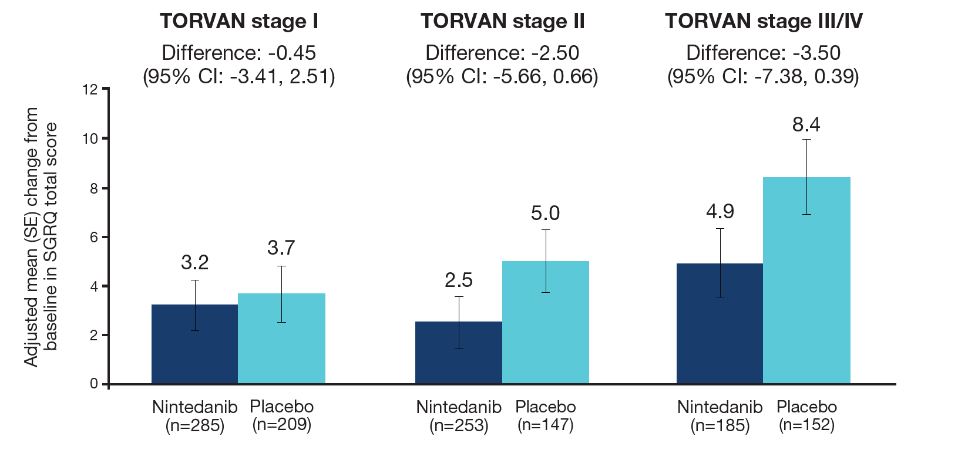
Change from baseline in SGRQ total score at week 52
Treatment-by-subgroup interaction p=0.21.
Torrisi SE et al. Efficacy and safety of nintedanib in patients with idiopathic pulmonary fibrosis (IPF): subgroup analyses by TORVAN stage. Poster developed for the American Thoracic Society International Conference, 2020.

Slide 13
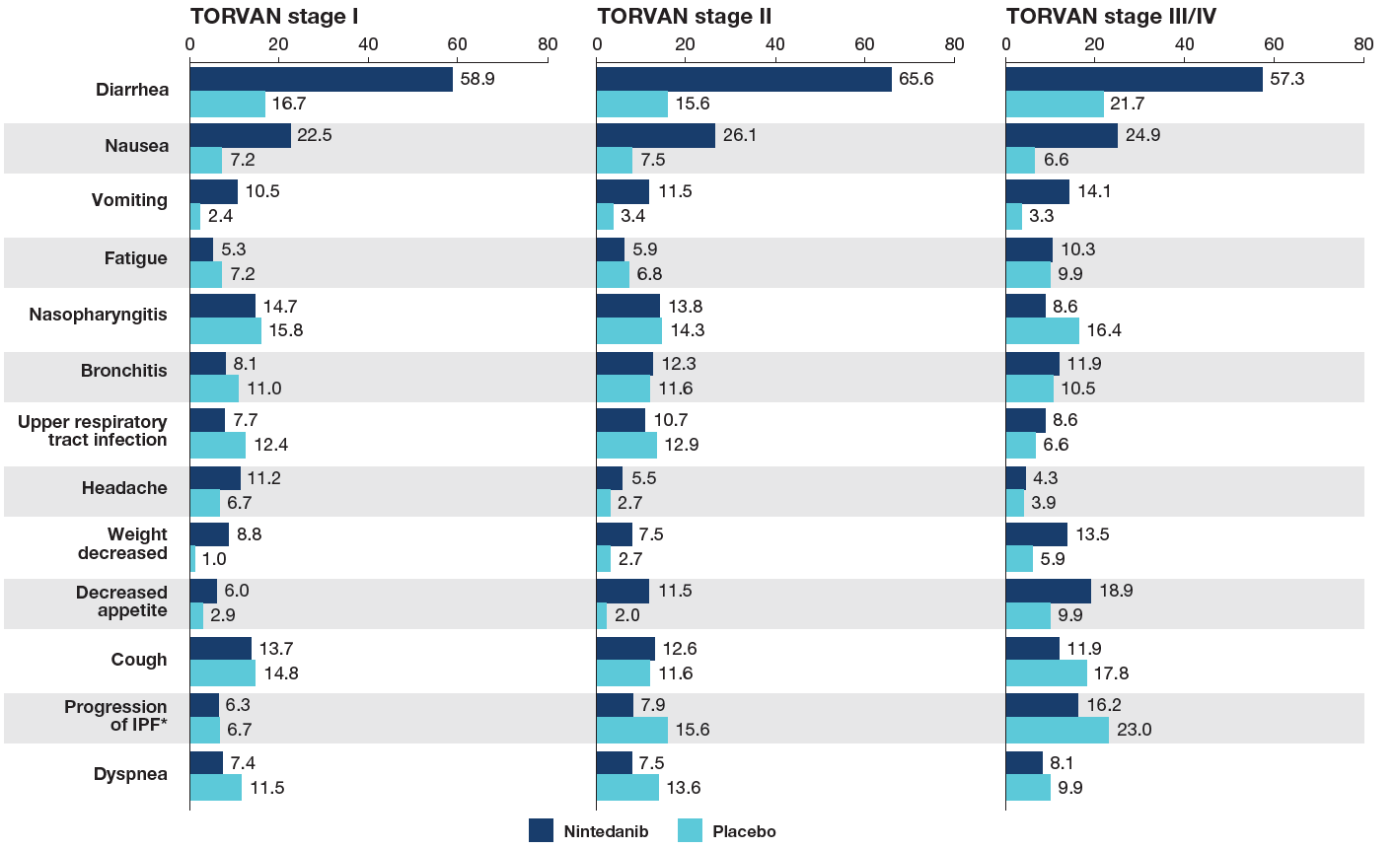
Most frequent adverse events
Data are % of subjects with ≥1 such adverse event reported (irrespective of causality) in >10% of subjects in any of these subgroups, coded using preferred terms in the Medical Dictionary for Regulatory Activities (MedDRA). Adverse events with onset after the first dose and up to 28 days (in INPULSIS trials) or 14 days (in TOMORROW trial) after the last dose of study drug are shown. *Corresponded to MedDRA term ‘IPF’, which included disease worsening and acute exacerbations of IPF.
Torrisi SE et al. Efficacy and safety of nintedanib in patients with idiopathic pulmonary fibrosis (IPF): subgroup analyses by TORVAN stage. Poster developed for the American Thoracic Society International Conference, 2020.

Slide 14
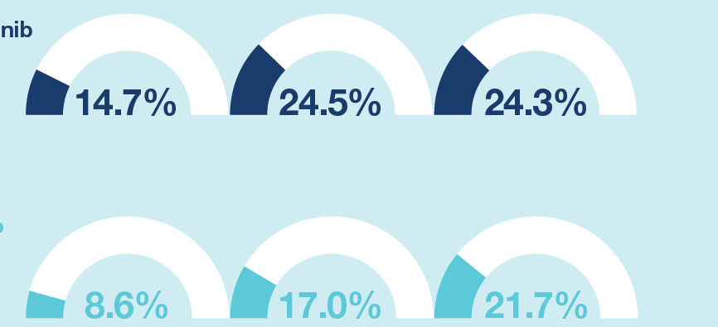
Adverse events leading to discontinuation of trial drug
TORVAN stage I
TORVAN stage II
TORVAN stage III/IV
Nintedanib
Placebo
Data are % of subjects with ≥1 such adverse event with onset after the first dose and up to 28 days (in INPULSIS trials) or 14 days (in TOMORROW trial) after the last dose of study drug.
Torrisi SE et al. Efficacy and safety of nintedanib in patients with idiopathic pulmonary fibrosis (IPF): subgroup analyses by TORVAN stage. Poster developed for the American Thoracic Society International Conference, 2020.

Slide 15
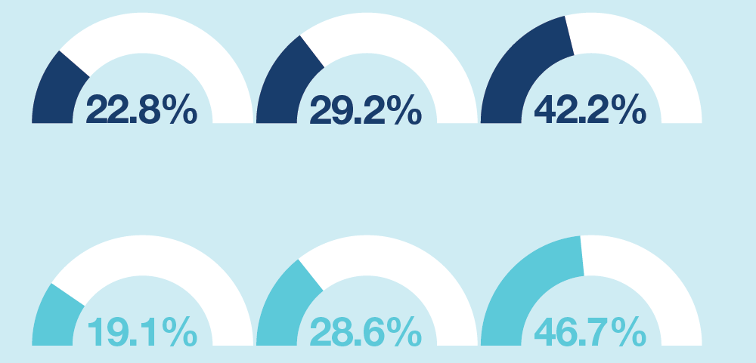
Serious adverse events
TORVAN stage I
TORVAN stage II
TORVAN stage III/IV
Nintedanib
Placebo
Data are % of subjects with ≥1 such adverse event with onset after the first dose and up to 28 days (in INPULSIS trials) or 14 days (in TOMORROW trial) after the last dose of study drug.
Serious adverse events were defined as events that resulted in death, were life-threatening, resulted in hospitalization or prolonged hospitalization, resulted in persistent or clinically significant disability or incapacity, were a congenital anomaly or birth defect, or were deemed serious for any other reason.
Torrisi SE et al. Efficacy and safety of nintedanib in patients with idiopathic pulmonary fibrosis (IPF): subgroup analyses by TORVAN stage. Poster developed for the American Thoracic Society International Conference, 2020.

Slide 16
Conclusions
In patients with IPF, the effect of nintedanib in reducing the rate of decline in FVC was similar irrespective of TORVAN stage at baseline
The adverse event profile of nintedanib was consistent across subgroups by TORVAN stage. In both the nintedanib and placebo groups, adverse events leading to treatment discontinuation were more frequent in patients at TORVAN stages II to IV than stage I, while the proportion of patients with serious adverse events increased with TORVAN stage
Torrisi SE et al. Efficacy and safety of nintedanib in patients with idiopathic pulmonary fibrosis (IPF): subgroup analyses by TORVAN stage. Poster developed for the American Thoracic Society International Conference, 2020.

Slide 17
Acknowledgements
The TOMORROW and INPULSIS trials were funded by Boehringer Ingelheim
Editorial and formatting assistance, supported financially by Boehringer Ingelheim, was provided by Elizabeth Ng and Wendy Morris of FleishmanHillard Fishburn, London, UK during preparation of the poster on which these slides were based. The authors were fully responsible for all content and editorial decisions, were involved at all stages of poster development and have approved the final version. The authors received no direct compensation related to development of the poster or slides. Boehringer Ingelheim was given the opportunity to review the poster for medical and scientific accuracy as well as intellectual property considerations

