Slide 1
Does HRCT pattern influence the effect of nintedanib in patients with progressive fibrosing interstitial lung diseases (ILDs)?
Brown KK et al. Does HRCT pattern influence the effect of nintedanib in patients with progressive fibrosing interstitial lung diseases (ILDs)? Poster developed for the American Thoracic Society International Conference, 2020.

Slide 2
Introduction
Nintedanib has been approved by the FDA for the treatment of IPF, systemic sclerosis-associated ILD, and chronic fibrosing ILDs with a progressive phenotype
In the INBUILD trial conducted in subjects with chronic fibrosing ILDs with a progressive phenotype (other than IPF), nintedanib slowed the rate of decline in FVC versus placebo, with adverse events that were manageable for most subjects¹
Previous studies suggested that the progression of progressive fibrosing ILDs is more rapid in subjects with a UIP-like pattern on HRCT^{2,3}
IPF, idiopathic pulmonary fibrosis; FVC, forced vital capacity; HRCT, high-resolution computed tomography; UIP, usual interstitial pneumonia.
1. Flaherty KR et al. N Engl J Med 2019;381:1718–27; 2. Zamora-Legoff JA et al. Arthritis Rheumatol 2017;69:542-549; 3.Salisbury ML et al. Chest 2019;155:699-711.
Brown KK et al. Does HRCT pattern influence the effect of nintedanib in patients with progressive fibrosing interstitial lung diseases (ILDs)? Poster developed for the American Thoracic Society International Conference, 2020.

Slide 3
Aim
To assess the effect of nintedanib versus placebo in the INBUILD trial in subgroups by HRCT pattern
Brown KK et al. Does HRCT pattern influence the effect of nintedanib in patients with progressive fibrosing interstitial lung diseases (ILDs)? Poster developed for the American Thoracic Society International Conference, 2020.

Slide 4
Methods
Subjects had an ILD other than IPF, diagnosed according to the investigator’s usual clinical practice; diffuse fibrosing ILD of >10% extent on HRCT; FVC ≥45% predicted; DLco ≥30%–<80% predicted
Subjects met ≥1 of the following criteria for ILD progression in the 24 months before screening, despite management deemed appropriate in clinical practice:
Relative decline in FVC ≥10% predicted
Relative decline in FVC ≥5–<10% predicted and increased extent of fibrosis on HRCT
Relative decline in FVC ≥5–<10% predicted and worsened respiratory symptoms
Worsened respiratory symptoms and increased extent of fibrosis on HRCT
Subjects were randomized 1:1 to receive nintedanib 150 mg bid or placebo, stratified by HRCT pattern (UIP-like fibrotic pattern or other fibrotic patterns) based on central review by expert radiologists
There were two co-primary analysis populations: the overall population and subjects with a UIP-like fibrotic pattern on HRCT
DLco, diffusion capacity of the lung for carbon monoxide.
Brown KK et al. Does HRCT pattern influence the effect of nintedanib in patients with progressive fibrosing interstitial lung diseases (ILDs)? Poster developed for the American Thoracic Society International Conference, 2020.

Slide 5
Fibrotic patterns on HRCT
Brown KK et al. Does HRCT pattern influence the effect of nintedanib in patients with progressive fibrosing interstitial lung diseases (ILDs)? Poster developed for the American Thoracic Society International Conference, 2020.

Slide 6
Analyses
In pre-specified analyses, the effect of nintedanib versus placebo on the following endpoints over 52 weeks was assessed in subgroups with a UIP-like fibrotic pattern and other fibrotic patterns on HRCT at baseline:
Rate of decline in FVC (mL/year)
Change from baseline in K-BILD questionnaire total score
Time to acute exacerbation or death
Time to absolute decline from baseline in FVC ≥10% predicted or death
Interaction p-values were calculated to assess potential heterogeneity in the treatment effect of nintedanib versus placebo between subgroups. No adjustment for multiplicity was made
K-BILD, King’s Brief Interstitial Lung Disease.
Brown KK et al. Does HRCT pattern influence the effect of nintedanib in patients with progressive fibrosing interstitial lung diseases (ILDs)? Poster developed for the American Thoracic Society International Conference, 2020.
Notes:
Table 1.1.74.2.1
Table 1.1.74.10.1
Table 1.1.74.12.1

Slide 7
Baseline characteristics
Brown KK et al. Does HRCT pattern influence the effect of nintedanib in patients with progressive fibrosing interstitial lung diseases (ILDs)? Poster developed for the American Thoracic Society International Conference, 2020.

Slide 8
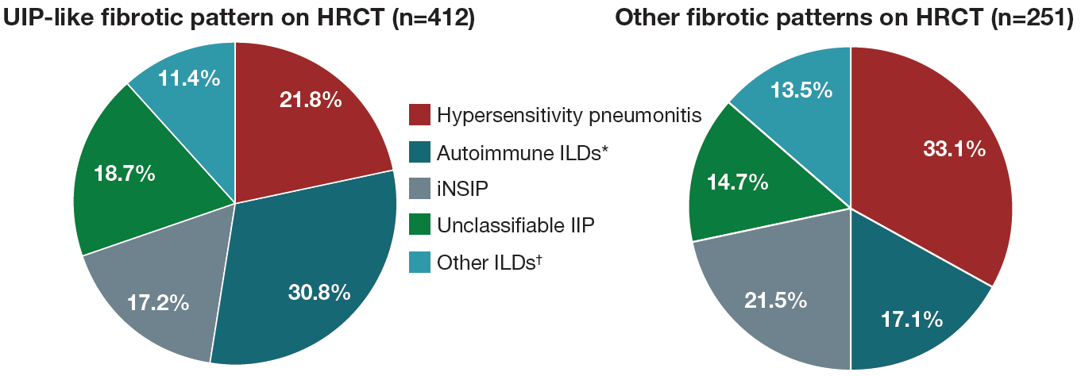
ILD diagnoses in subgroups by fibrotic pattern on HRCT
*Included ILD associated with rheumatoid arthritis, systemic sclerosis, and mixed connective tissue disease, plus subjects with an autoimmune disease noted in the “Other fibrosing ILDs” category of the case report form. †Included sarcoidosis, exposure-related ILDs and selected terms in the “Other fibrosing ILDs” category of the case report form.
Brown KK et al. Does HRCT pattern influence the effect of nintedanib in patients with progressive fibrosing interstitial lung diseases (ILDs)? Poster developed for the American Thoracic Society International Conference, 2020.

Slide 9
Annual rate of decline in FVC (mL/year)
In subjects who received placebo, the rate of decline in FVC over 52 weeks was numerically greater in subjects with a UIP-like fibrotic pattern on HRCT than in those with other fibrotic patterns on HRCT (−209.2 [SE 19.1] versus −155.4 [23.6] mL/year)
The difference between the nintedanib and placebo groups in the annual rate of decline in FVC was 127.8 (95% CI: 74.3, 181.2) mL/year in subjects with a UIP-like fibrotic pattern on HRCT and 75.4 (95% CI: 9.5, 141.4) mL/year in subjects with other fibrotic patterns on HRCT (treatment-by-subgroup-by-time interaction p=0.23)
Brown KK et al. Does HRCT pattern influence the effect of nintedanib in patients with progressive fibrosing interstitial lung diseases (ILDs)? Poster developed for the American Thoracic Society International Conference, 2020.

Slide 10
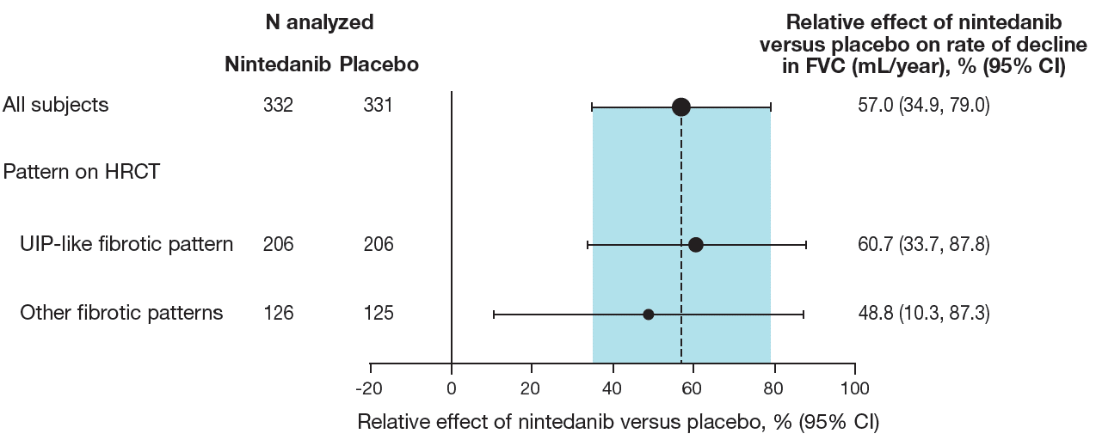
Relative effect of nintedanib versus placebo on the annual rate of decline in FVC (mL/year) over 52 weeks
Brown KK et al. Does HRCT pattern influence the effect of nintedanib in patients with progressive fibrosing interstitial lung diseases (ILDs)? Poster developed for the American Thoracic Society International Conference, 2020.

Slide 11
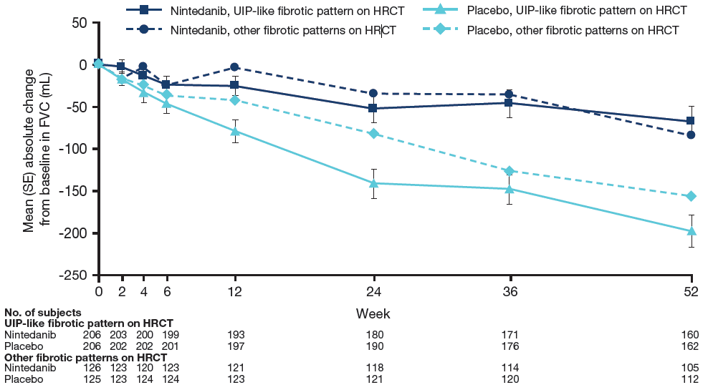
Observed change from baseline in FVC (mL) over 52 weeks
Brown KK et al. Does HRCT pattern influence the effect of nintedanib in patients with progressive fibrosing interstitial lung diseases (ILDs)? Poster developed for the American Thoracic Society International Conference, 2020.

Slide 12
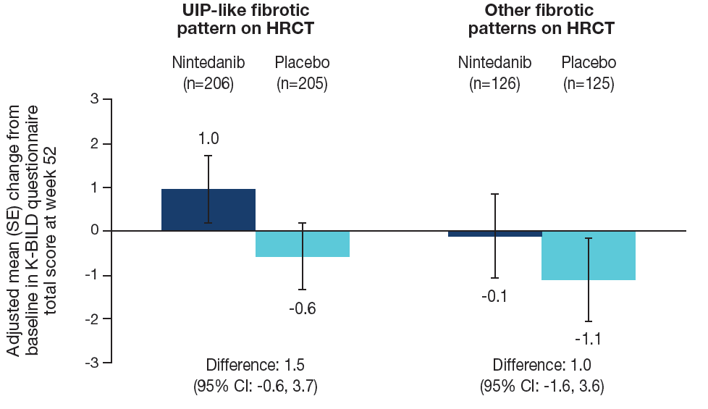
Change in K-BILD questionnaire total score at week 52
Treatment-by-visit-by-subgroup interaction p=0.76. K-BILD questionnaire total scores range from 0–100, with higher scores representing better health status.
Brown KK et al. Does HRCT pattern influence the effect of nintedanib in patients with progressive fibrosing interstitial lung diseases (ILDs)? Poster developed for the American Thoracic Society International Conference, 2020.

Slide 13
Time to first acute exacerbation of ILD or death, and absolute decline in FVC ≥10% predicted or death
 | UIP-like fibrotic pattern on HRCT |  | Other fibrotic patterns on HRCT
 | Nintedanib (n=206) | Placebo (n=206) | Nintedanib (n=126) | Placebo (n=125)
Acute exacerbation of ILD or death over 52 weeks, n (%) | 17 (8.3) | 25 (12.1) | 9 (7.1) | 7 (5.6)
HR (95% CI) | 0.67 (0.36, 1.24) |  | 1.26 (0.47, 3.39)
Treatment-by-subgroup interaction | p=0.28
Absolute decline in FVC ≥10% predicted or death over 52 weeks, n (%) | 56 (27.2) | 82 (39.8) | 29 (23.0) | 42 (33.6)
HR (95% CI) | 0.64 (0.45, 0.89) |  | 0.67 (0.42, 1.07)
Treatment-by-subgroup interaction | p=0.84
Brown KK et al. Does HRCT pattern influence the effect of nintedanib in patients with progressive fibrosing interstitial lung diseases (ILDs)? Poster developed for the American Thoracic Society International Conference, 2020.

Slide 14
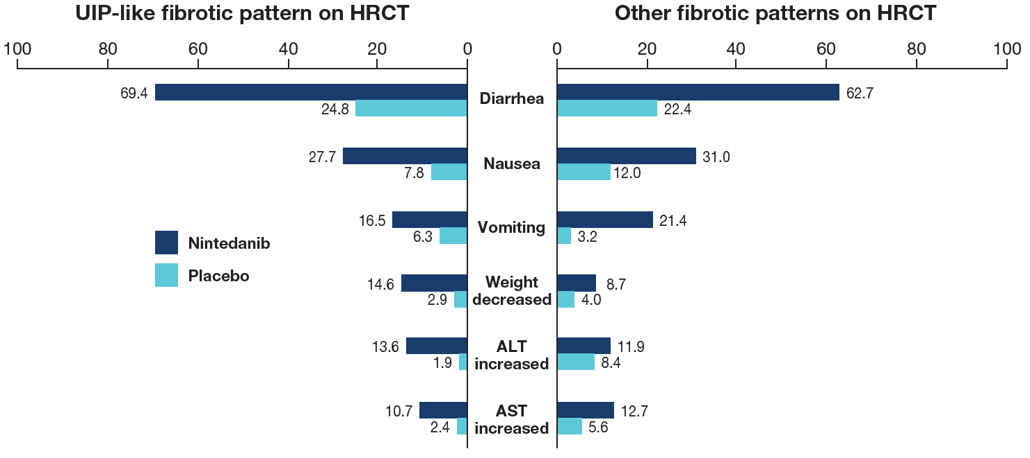
Most frequent gastrointestinal, weight loss and hepatic adverse events
Gastrointestinal, weight loss and liver enzyme adverse events, coded using preferred terms in the Medical Dictionary for Regulatory activities (MedDRA), reported in >10% of subjects in any of the subgroups are shown. Data are % of subjects with ≥1 such adverse event, reported over 52 weeks (or until 28 days after last trial drug intake in subjects who discontinued trial drug before week 52). ALT, alanine aminotransferase; AST, aspartate aminotransferase.
Brown KK et al. Does HRCT pattern influence the effect of nintedanib in patients with progressive fibrosing interstitial lung diseases (ILDs)? Poster developed for the American Thoracic Society International Conference, 2020.

Slide 15
Serious and fatal adverse events
 | UIP-like fibrotic pattern on HRCT |  | Other fibrotic patterns on HRCT
 | Nintedanib (n=206) | Placebo (n=206) | Nintedanib (n=126) | Placebo (n=125)
Serious adverse events | 30.6 | 37.4 | 34.9 | 26.4
Fatal adverse events | 3.4 | 7.8 | 3.2 | 0.8
Data are % of subjects with ≥1 such adverse event, reported over 52 weeks (or until 28 days after last trial drug intake in subjects who discontinued trial drug before week 52).
Brown KK et al. Does HRCT pattern influence the effect of nintedanib in patients with progressive fibrosing interstitial lung diseases (ILDs)? Poster developed for the American Thoracic Society International Conference, 2020.

Slide 16
Conclusions
In subjects with chronic fibrosing ILDs and a progressive phenotype who received placebo in the INBUILD trial, the annual rate of decline in FVC was numerically greater in subjects with a UIP-like fibrotic pattern on HRCT than in those with other fibrotic patterns on HRCT
The relative treatment effect of nintedanib on slowing the rate of FVC decline was consistent between subjects with a UIP-like fibrotic pattern and other fibrotic patterns on HRCT, and similar to that observed in subjects with IPF in the INPULSIS trials¹
Nintedanib was associated with a numerically reduced risk of an absolute decline in FVC ≥10% predicted or death in both subgroups by fibrotic pattern on HRCT
1. Richeldi L et al. N Engl J Med 2014;370:2071-82.

Slide 17
Acknowledgements
The INBUILD trial was funded by Boehringer Ingelheim
Medical writing assistance, supported financially by Boehringer Ingelheim, was provided by Elizabeth Ng and Wendy Morris of FleishmanHillard Fishburn, London, UK during preparation of the poster on which these slides were based. The authors were fully responsible for all content and editorial decisions, were involved at all stages of poster development and have approved the final version. Boehringer Ingelheim was given the opportunity to review the poster for medical and scientific accuracy as well as intellectual property considerations

