Slide 1
Efficacy and safety of nintedanib in patients with SSc-ILD by body mass index (BMI) at baseline: subgroup analysis of the SENSCIS® trial
Jouneau S et al. Efficacy and safety of nintedanib in patients with systemic sclerosis-associated interstitial lung disease (SSc-ILD) by body mass index (BMI) at baseline: subgroup analysis of the SENSCIS trial. Poster developed for the American Thoracic Society International Conference, 2020.

Slide 2
Introduction
SSc is commonly associated with gastrointestinal complications, which increase the risk of malabsorption and underweight¹
In the SENSCIS trial in subjects with SSc-ILD, nintedanib reduced the rate of decline in forced vital capacity (FVC) (mL/year) over 52 weeks by 44% compared with placebo, with an adverse event profile characterized mainly by gastrointestinal events²
1. Forbes A and Marie I. Rheumatology (Oxford) 2009;48:iii36–9; 2. Distler O et al. N Engl J Med 2019;380:2518–28.
Jouneau S et al. Efficacy and safety of nintedanib in patients with systemic sclerosis-associated interstitial lung disease (SSc-ILD) by body mass index (BMI) at baseline: subgroup analysis of the SENSCIS trial. Poster developed for the American Thoracic Society International Conference, 2020.

Slide 3
Aim
To assess the efficacy and safety of nintedanib in patients with SSc-ILD in subgroups by baseline body mass index (BMI)
Jouneau S et al. Efficacy and safety of nintedanib in patients with systemic sclerosis-associated interstitial lung disease (SSc-ILD) by body mass index (BMI) at baseline: subgroup analysis of the SENSCIS trial. Poster developed for the American Thoracic Society International Conference, 2020.

Slide 4
Methods
Inclusion criteria included SSc with first non-Raynaud symptom <7 years before screening, fibrotic ILD of ≥10% extent on an HRCT scan, FVC ≥40% predicted and DLco 30–89% predicted
Subjects taking prednisone ≤10 mg/day and/or stable therapy with mycophenolate or methotrexate for ≥6 months prior to randomization were allowed to participate
Subjects were randomized to receive nintedanib or placebo until the last subject had reached week 52 but for ≤100 weeks
DLco, diffusion capacity of the lung for carbon monoxide; HRCT, high-resolution computed tomography.
Jouneau S et al. Efficacy and safety of nintedanib in patients with systemic sclerosis-associated interstitial lung disease (SSc-ILD) by body mass index (BMI) at baseline: subgroup analysis of the SENSCIS trial. Poster developed for the American Thoracic Society International Conference, 2020.

Slide 5
Analyses
Based on the distribution of BMI at baseline, we analyzed outcomes in subgroups with baseline BMI above and below the median (25 kg/m²):
Rate of decline in FVC (mL/year)
Categorical declines in FVC
Time to absolute decline in FVC ≥10% predicted or death
The number of subjects who were underweight (BMI<18.5 kg/m²) at baseline (n=21) was too low for this subgroup to be analyzed separately
Jouneau S et al. Efficacy and safety of nintedanib in patients with systemic sclerosis-associated interstitial lung disease (SSc-ILD) by body mass index (BMI) at baseline: subgroup analysis of the SENSCIS trial. Poster developed for the American Thoracic Society International Conference, 2020.

Slide 6
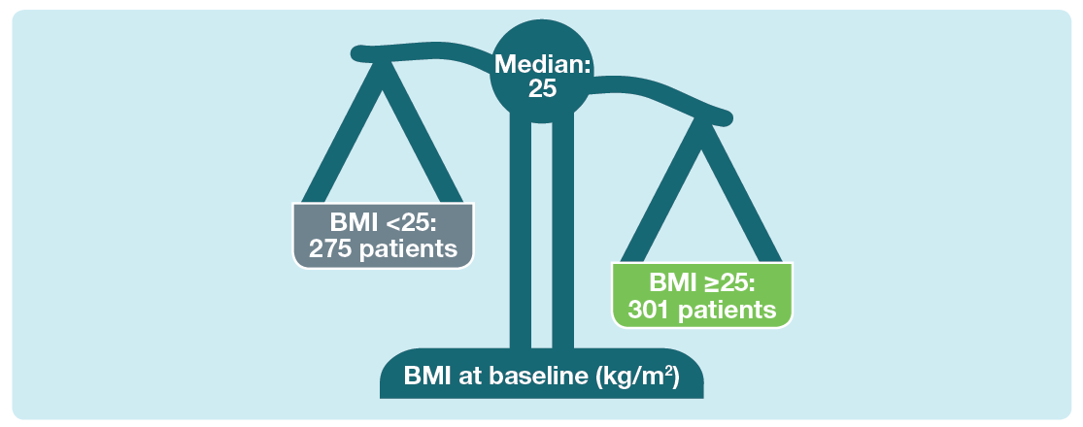
Distribution of BMI at baseline
Jouneau S et al. Efficacy and safety of nintedanib in patients with systemic sclerosis-associated interstitial lung disease (SSc-ILD) by body mass index (BMI) at baseline: subgroup analysis of the SENSCIS trial. Poster developed for the American Thoracic Society International Conference, 2020.

Slide 7
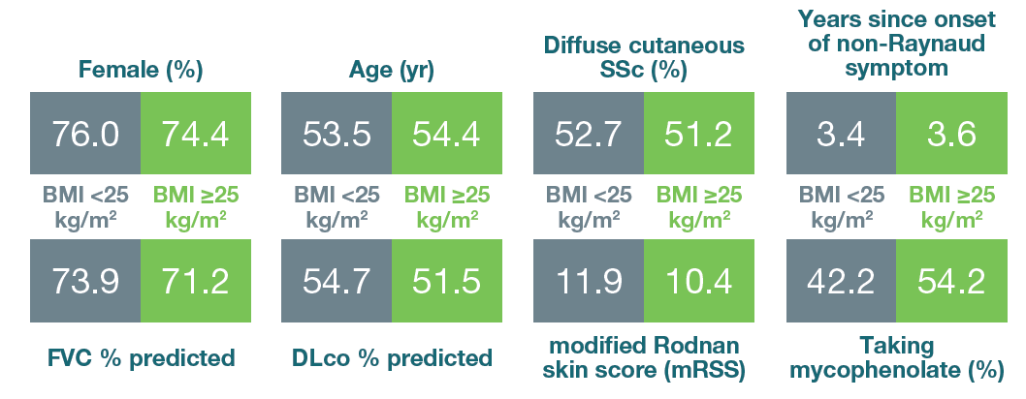
Baseline characteristics of subgroups by BMI <25 and ≥25 kg/m² at baseline
Mean or % of patients.
Jouneau S et al. Efficacy and safety of nintedanib in patients with systemic sclerosis-associated interstitial lung disease (SSc-ILD) by body mass index (BMI) at baseline: subgroup analysis of the SENSCIS trial. Poster developed for the American Thoracic Society International Conference, 2020.

Slide 8
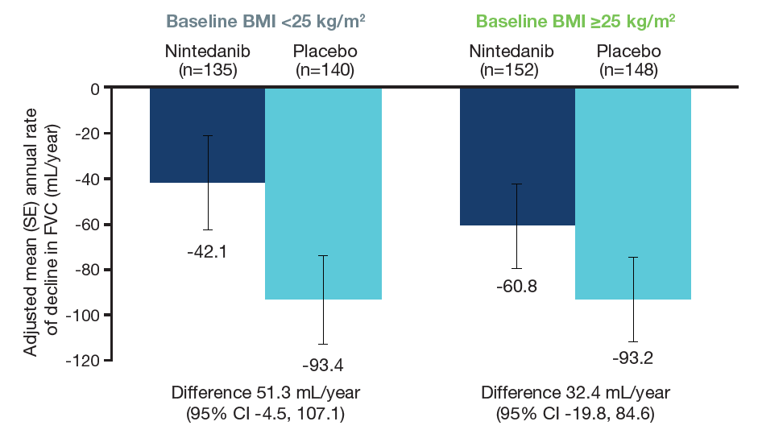
Annual rate of decline in FVC (mL/yr) over 52 weeks in subgroups by BMI at baseline
Treatment-by-time-by-subgroup interaction p=0.63.
Jouneau S et al. Efficacy and safety of nintedanib in patients with systemic sclerosis-associated interstitial lung disease (SSc-ILD) by body mass index (BMI) at baseline: subgroup analysis of the SENSCIS trial. Poster developed for the American Thoracic Society International Conference, 2020.

Slide 9
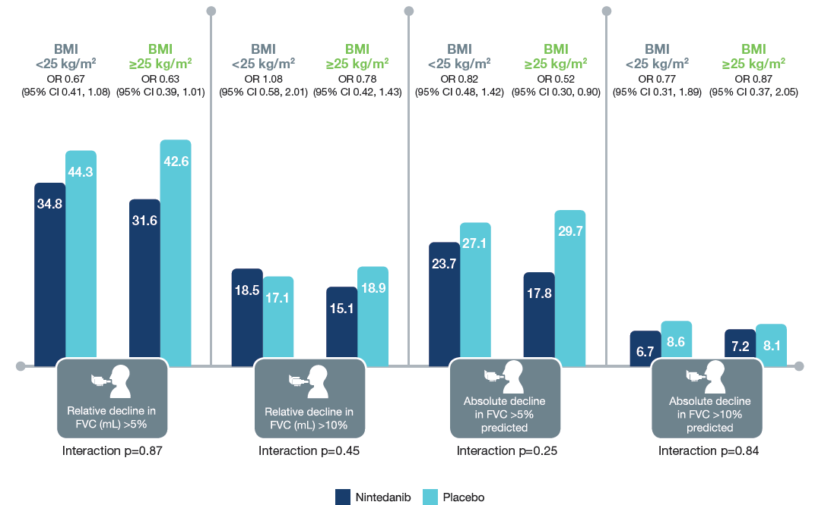
Absolute and relative declines in FVC in subgroups by BMI at baseline
OR, odds ratio. Missing data were imputed using a worst value carried forward approach.
Jouneau S et al. Efficacy and safety of nintedanib in patients with systemic sclerosis-associated interstitial lung disease (SSc-ILD) by body mass index (BMI) at baseline: subgroup analysis of the SENSCIS trial. Poster developed for the American Thoracic Society International Conference, 2020.

Slide 10
Time to absolute decline in FVC ≥10% predicted or death in subgroups by BMI at baseline
 | BMI <25 kg/m² |  | BMI ≥25 kg/m²
 | Nintedanib (n=135) | Placebo (n=140) | Nintedanib (n=153) | Placebo (n=148)
Absolute decline in FVC ≥10% predicted or death over 52 weeks, n (%) | 24 (17.8) | 32 (22.9) | 16 (10.5) | 30 (20.3)
Hazard ratio (95% CI) | 0.77 (0.45, 1.31) |  | 0.48 (0.26, 0.89)
Treatment-by-subgroup interaction | p=0.28
Jouneau S et al. Efficacy and safety of nintedanib in patients with systemic sclerosis-associated interstitial lung disease (SSc-ILD) by body mass index (BMI) at baseline: subgroup analysis of the SENSCIS trial. Poster developed for the American Thoracic Society International Conference, 2020.

Slide 11
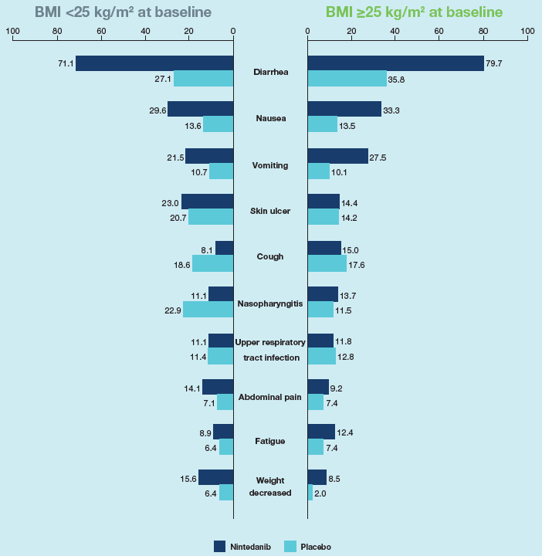
Most frequent adverse events (reported irrespective of causality) in subgroups by BMI at baseline
Adverse events reported in >10% of subjects in either treatment group in the overall population, coded using preferred terms in the Medical Dictionary for Regulatory Activities (MedDRA), are shown. Data are % of subjects with ≥1 such adverse event, reported over 52 weeks (or until 28 days after last trial drug intake in subjects who discontinued trial drug before week 52).

Slide 12
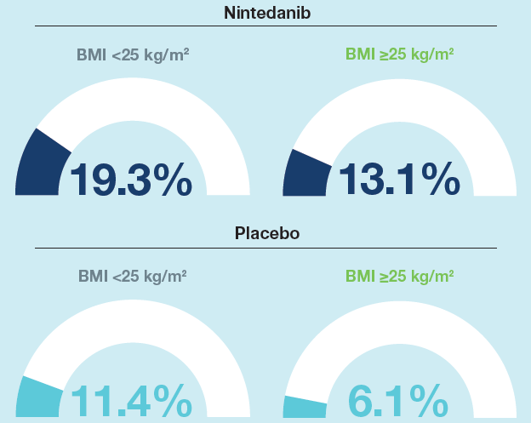
Adverse events leading to treatment discontinuation in subgroups by BMI at baseline
Diarrhea was the most frequent adverse event that led to discontinuation of nintedanib (7.4% and 6.5% of subjects with BMI <25 and ≥25 kg/m², respectively)
One subject discontinued nintedanib due to an adverse event of weight loss
Data are % of subjects with ≥1 such adverse event reported over 52 weeks.
Jouneau S et al. Efficacy and safety of nintedanib in patients with systemic sclerosis-associated interstitial lung disease (SSc-ILD) by body mass index (BMI) at baseline: subgroup analysis of the SENSCIS trial. Poster developed for the American Thoracic Society International Conference, 2020.

Slide 13
Conclusions
The effect of nintedanib in reducing the rate of FVC decline was consistent between subgroups by baseline BMI <25 and ≥25 kg/m²
The adverse event profile of nintedanib was similar between subgroups by BMI <25 and ≥25 kg/m². In both treatment groups, adverse events leading to discontinuation of trial drug were more common in patients with BMI <25 than >25 kg/m² at baseline.
Weight loss was reported more frequently as an adverse event, but did not lead to a higher frequency of treatment discontinuation, in subjects with BMI <25 than >25 kg/m² at baseline.
Jouneau S et al. Efficacy and safety of nintedanib in patients with systemic sclerosis-associated interstitial lung disease (SSc-ILD) by body mass index (BMI) at baseline: subgroup analysis of the SENSCIS trial. Poster developed for the American Thoracic Society International Conference, 2020.

Slide 14
Acknowledgements
The SENSCIS trial was funded by Boehringer Ingelheim
Editorial and formatting assistance, supported financially by Boehringer Ingelheim, was provided by Elizabeth Ng and Wendy Morris of FleishmanHillard Fishburn, London, UK, during preparation of the poster on which these slides were based. The authors were fully responsible for all content and editorial decisions, were involved at all stages of poster development and have approved the final version. The authors received no direct compensation related to the development of the poster or slides. Boehringer Ingelheim was given the opportunity to review the poster for medical and scientific accuracy as well as intellectual property considerations

