Slide 1
Disease progression events in trials of nintedanib in patients with idiopathic pulmonary fibrosis
Nathan SD et al. Disease progression events in trials of nintedanib in patients with idiopathic pulmonary fibrosis. Poster developed for the American Thoracic Society International Conference, 2020.

Slide 2
Introduction
IPF is a progressive fibrosing interstitial lung disease characterized by decline in lung function and high mortality¹
Acute exacerbations and hospitalizations are common features of the clinical course of IPF^{2,3}
1. Raghu G et al. Am J Respir Crit Care Med 2018;198:e44–e68. 2. Kreuter M et al. Respir Res 2019;20(1):59. 3. Fan Y et al. Chest 2020; doi: 10.1016/j.chest.2019.12.041.
Nathan SD et al. Disease progression events in trials of nintedanib in patients with idiopathic pulmonary fibrosis. Poster developed for the American Thoracic Society International Conference, 2020.

Slide 3
Aim
To assess events reflecting disease progression in patients with IPF treated with nintedanib versus placebo
Nathan SD et al. Disease progression events in trials of nintedanib in patients with idiopathic pulmonary fibrosis. Poster developed for the American Thoracic Society International Conference, 2020.

Slide 4
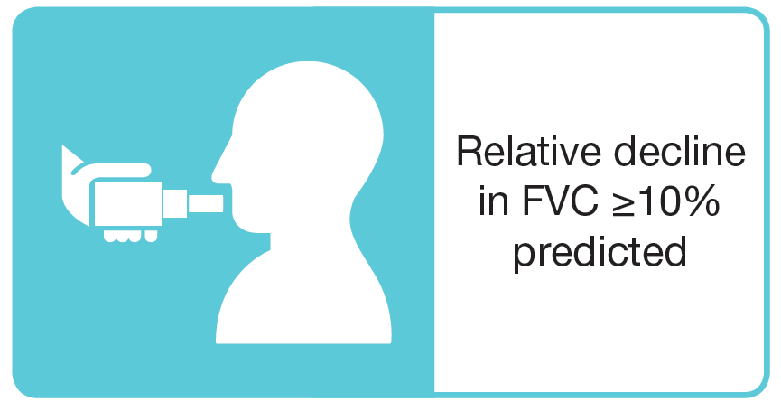
Methods
Data were pooled from the TOMORROW trial¹ and two INPULSIS trials² in which subjects were randomized to receive nintedanib or placebo
The occurrence of progression events over the 52-week treatment period plus 7 days was analyzed post-hoc
Events of the same type on different dates were counted as separate events; different events on the same date were counted as one event
Progression events were defined as:
1. Richeldi L et al. N Engl J Med 2011;365:1079–87. 2. Richeldi L et al. N Engl J Med 2014;370:2071–82. Nathan SD et al. Disease progression events in trials of nintedanib in patients with idiopathic pulmonary fibrosis. Poster developed for the American Thoracic Society International Conference, 2020.
Notes:
Table 1.1.74.2.1
Table 1.1.74.10.1
Table 1.1.74.12.1

Slide 5
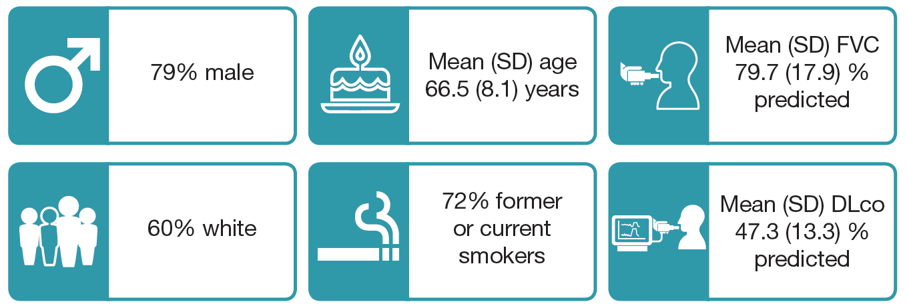
Baseline characteristics
Nathan SD et al. Disease progression events in trials of nintedanib in patients with idiopathic pulmonary fibrosis. Poster developed for the American Thoracic Society International Conference, 2020.

Slide 6
Progression events
Data are % of patients. Chi-squared test was used to calculate p-values. Nathan SD et al. Disease progression events in trials of nintedanib in patients with idiopathic pulmonary fibrosis. Poster developed for the American Thoracic Society International Conference, 2020.

Slide 7
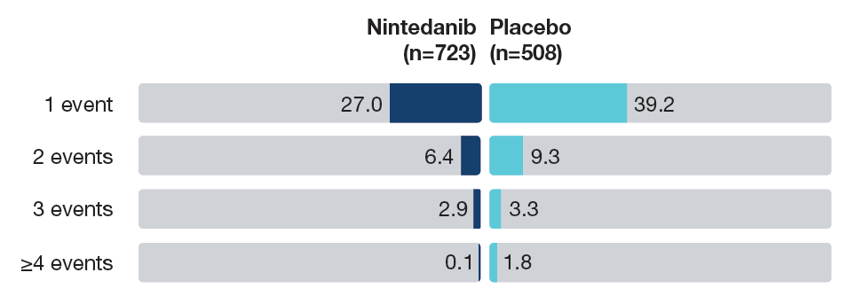
Number of progression events
Data are % of patients. Nathan SD et al. Disease progression events in trials of nintedanib in patients with idiopathic pulmonary fibrosis. Poster developed for the American Thoracic Society International Conference, 2020.

Slide 8
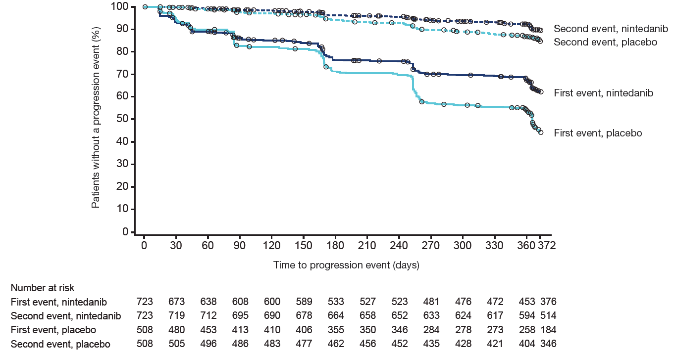
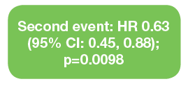
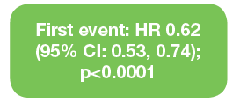
Time to first and second progression events
A log-rank test was used to compare treatment groups and a Cox model was used to determine hazard ratios.
Nathan SD et al. Disease progression events in trials of nintedanib in patients with idiopathic pulmonary fibrosis. Poster developed for the American Thoracic Society International Conference, 2020.

Slide 9
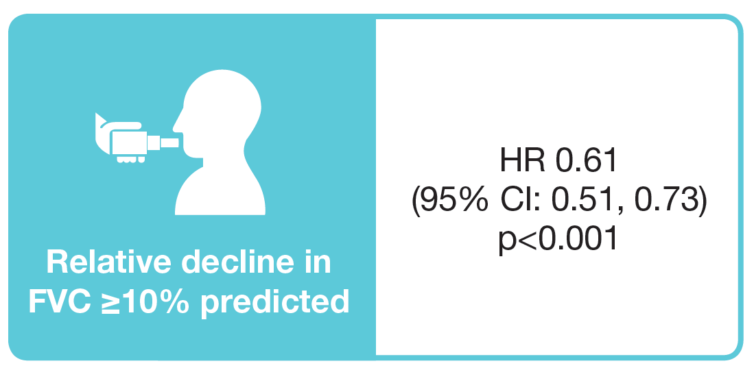
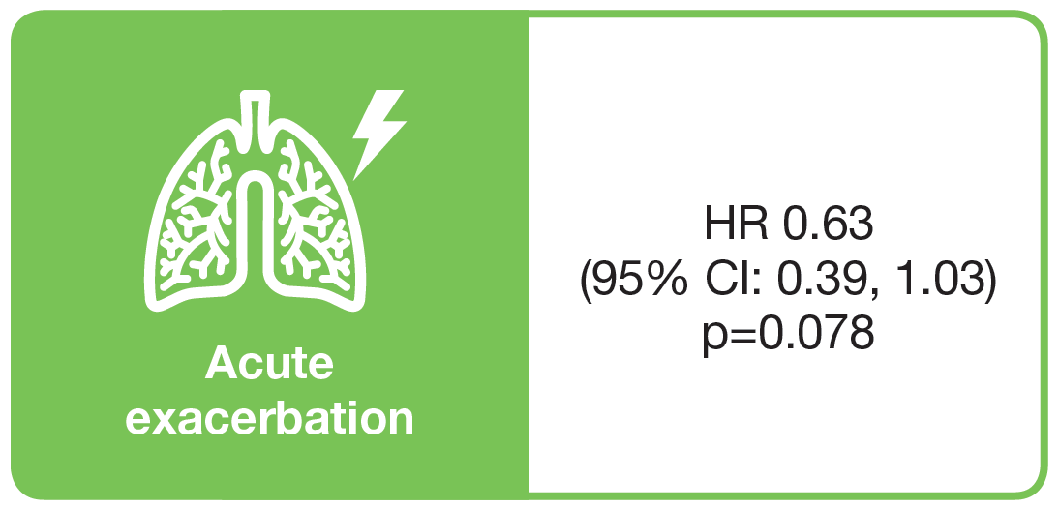
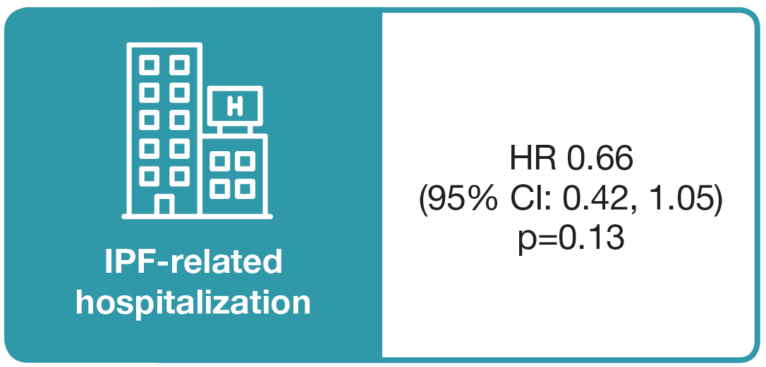
Time to first progression event by type of event
Nathan SD et al. Disease progression events in trials of nintedanib in patients with idiopathic pulmonary fibrosis. Poster developed for the American Thoracic Society International Conference, 2020.

Slide 10
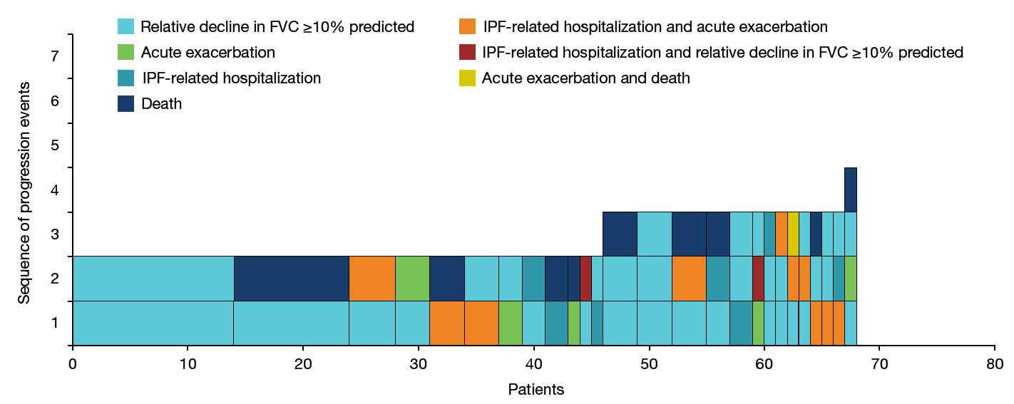
Incidence and sequence of disease progression events up to 52 weeks in patients who had >1 event: nintedanib group
This shows the number of patients with each sequence of progression events. The box at the bottom of the column represents the event that occurred first, the next box up the next event that occurred, and so on.
Nathan SD et al. Disease progression events in trials of nintedanib in patients with idiopathic pulmonary fibrosis. Poster developed for the American Thoracic Society International Conference, 2020.

Slide 11
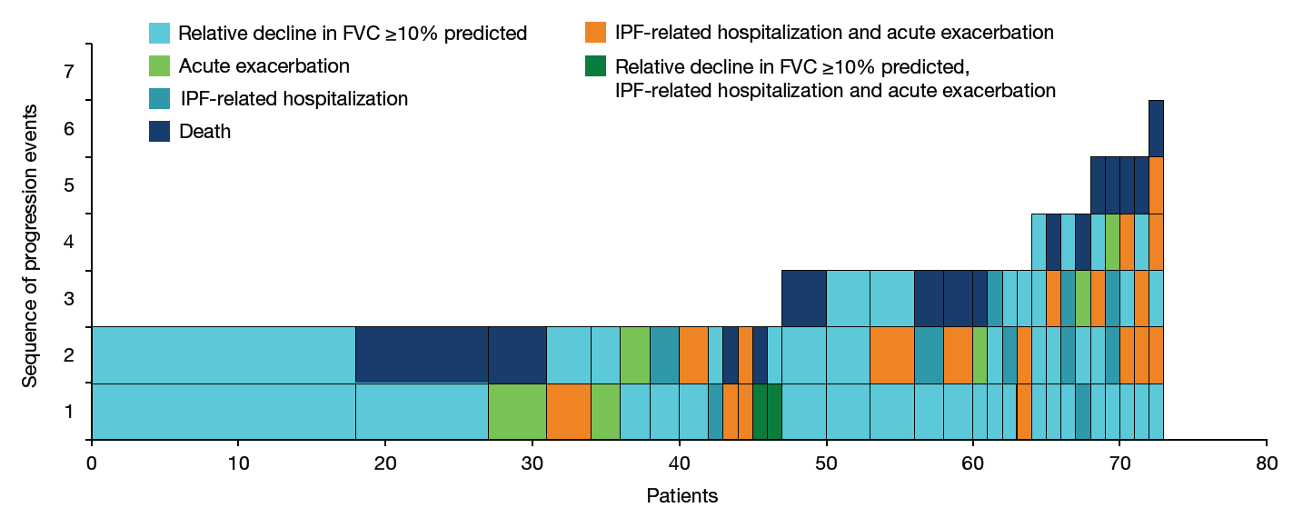
Incidence and sequence of disease progression events up to 52 weeks in patients who had >1 event: placebo group
This shows the number of patients with each sequence of progression events. The box at the bottom of the column represents the event that occurred first, the next box up the next event that occurred, and so on.
Nathan SD et al. Disease progression events in trials of nintedanib in patients with idiopathic pulmonary fibrosis. Poster developed for the American Thoracic Society International Conference, 2020.

Slide 12
Conclusions
In randomized controlled trials, events reflecting disease progression occurred in smaller proportions of patients with IPF treated with nintedanib than placebo over 52 weeks

Slide 13
Acknowledgements
The TOMORROW and INPULSIS trials were funded by Boehringer Ingelheim
Medical writing assistance, supported financially by Boehringer Ingelheim, was provided by Julie Fleming and Wendy Morris of FleishmanHillard Fishburn, London, UK during preparation of the poster on which these slides were based. The authors were fully responsible for all content and editorial decisions, were involved at all stages of poster development and have approved the final version. Boehringer Ingelheim was given the opportunity to review the poster for medical and scientific accuracy as well as intellectual property considerations

