Slide 1
Relationship between mRNA-microRNA interactions and forced vital capacity in patients with idiopathic pulmonary fibrosis

Slide 2
Introduction

Slide 3
Aim

Slide 4
Methods

Slide 5
Analyses (1/2)

Slide 6
Analyses (2/2)

Slide 7
Baseline characteristics of subjects in highest and lowest tertiles of FVC % predicted

Slide 8
Differential expression of mRNAs and microRNAs

Slide 9
Top mRNA-microRNA pairs from mRNAs and microRNAs differentially expressed between subjects in highest and lowest tertiles of FVC % predicted

Slide 10
mRNA-microRNA pair with strongest negative correlation

Slide 11
Functional analyses

Slide 12
Network of mRNA-microRNA interactions with adjusted p≤0.05

Slide 13
Pathways analysis: mRNA-microRNA pairs with a confirmed connection in ≥1 database searched

Slide 15
Acknowledgements

Slide 16
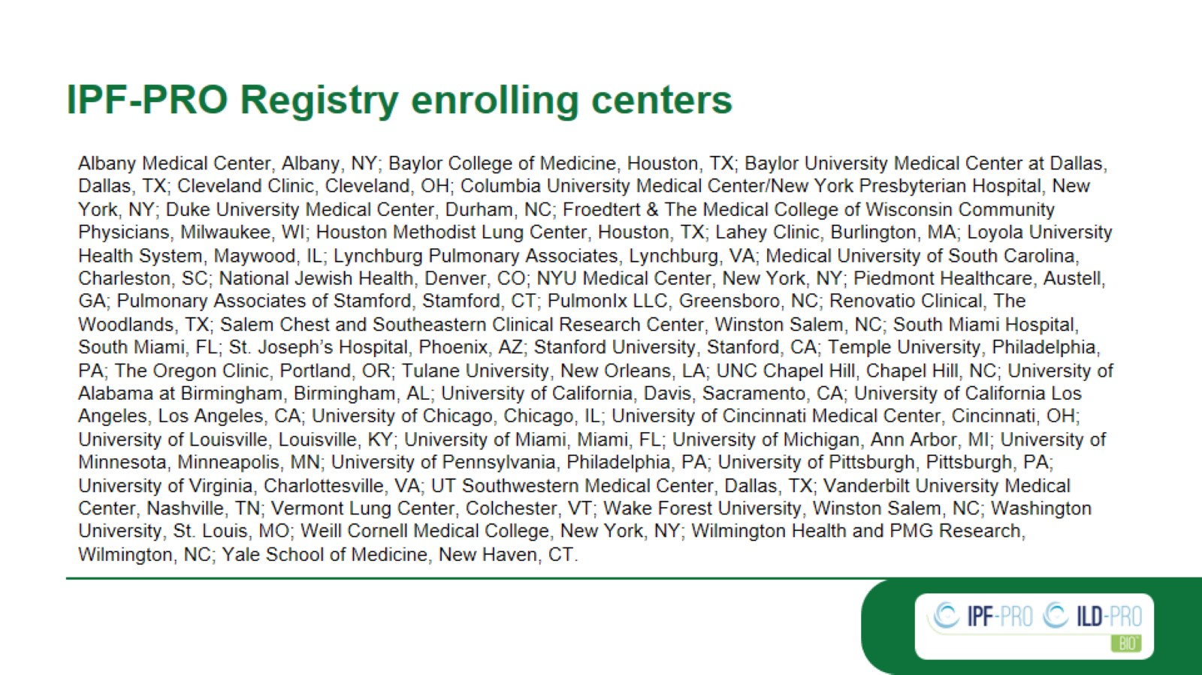
IPF-PRO Registry enrolling centers

