Slide 1
Improving our understanding of progressive fibrosing interstitial lung diseases (ILDs): design of the ILD-PRO™ Registry
Palmer S et al. Improving our understanding of progressive fibrosing interstitial lung diseases (ILDs): design of the ILD-PRO™ Registry. Poster developed for the American Thoracic Society International Conference, 2020.

Slide 2
Introduction
Idiopathic pulmonary fibrosis (IPF) is a chronic fibrosing ILD that is always progressive
A subset of patients with other chronic fibrosing ILDs also develop a progressive phenotype characterized by increasing fibrosis on HRCT; worsening lung function, symptoms and quality of life; and early mortality^{1,2}
In 2018, the Idiopathic Pulmonary Fibrosis Prospective Outcomes (IPF-PRO) Registry,³ an observational US registry involving 1002 patients with IPF, was expanded to include an additional arm comprising patients with non-IPF chronic progressive fibrosing ILDs to form the IPF-PRO/ILD-PRO Registry
1. Wells AU, et al. Eur Respir J 2018;51. pii:1800692.
2. Brown KK, et al. Eur Respir J 2020; pii: 2000085.
3. O’Brien EC, et al. BMJ Open Respir Res 2016;3:e000108.
Palmer S et al. Improving our understanding of progressive fibrosing interstitial lung diseases (ILDs): design of the ILD-PRO Registry. Poster developed for the American Thoracic Society International Conference, 2020.

Slide 3
Aim
To describe the objectives and design of the ILD-PRO Registry
Palmer S et al. Improving our understanding of progressive fibrosing interstitial lung diseases (ILDs): design of the ILD-PRO Registry. Poster developed for the American Thoracic Society International Conference, 2020.

Slide 4
Objectives of the ILD-PRO Registry
Describe current approaches to the diagnosis of chronic
progressive fibrosing ILDs
Examine the natural history of chronic progressive fibrosing ILDs and their impact on patients, including on their quality
of life
Describe interactions with the healthcare system and
treatment practices among patients with chronic progressive fibrosing ILDs
Investigate disease biomarkers using biological samples linked to clinical data
Palmer S et al. Improving our understanding of progressive fibrosing interstitial lung diseases (ILDs): design of the ILD-PRO Registry. Poster developed for the American Thoracic Society International Conference, 2020.

Slide 5
Design of the ILD-PRO Registry (1/3)
The ILD-PRO Registry will enroll patients with chronic progressive fibrosing ILDs other than IPF at over 45 sites across the US
Palmer S et al. Improving our understanding of progressive fibrosing interstitial lung diseases (ILDs): design of the ILD-PRO Registry. Poster developed for the American Thoracic Society International Conference, 2020.

Slide 6
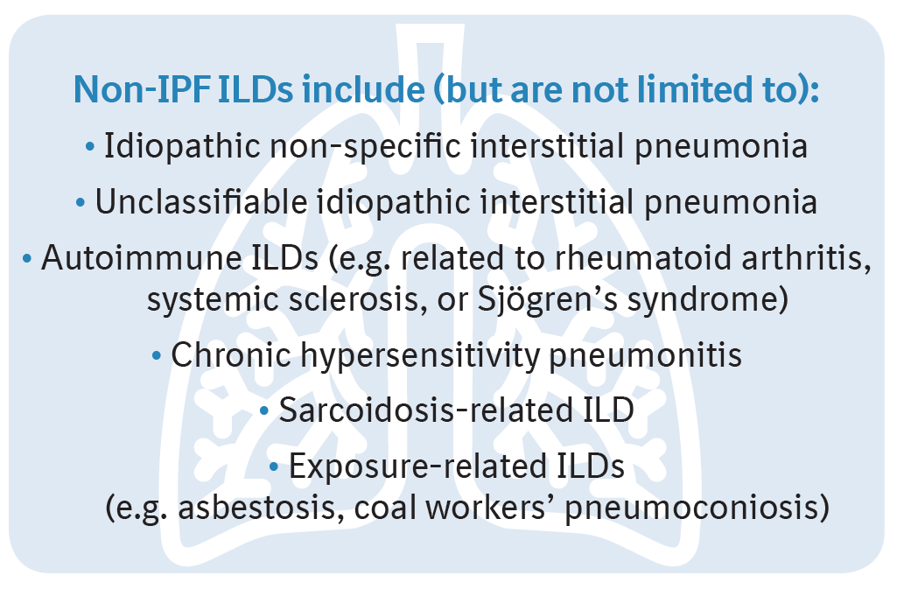
Design of the ILD-PRO Registry (2/3)
Patients aged ≥30 years with a non-IPF ILD of any duration that was diagnosed or confirmed at the enrolling center, and reticular abnormality and traction bronchiectasis (with or without honeycombing) confirmed by HRCT scan and/or lung biopsy
Palmer S et al. Improving our understanding of progressive fibrosing interstitial lung diseases (ILDs): design of the ILD-PRO Registry. Poster developed for the American Thoracic Society International Conference, 2020.

Slide 7
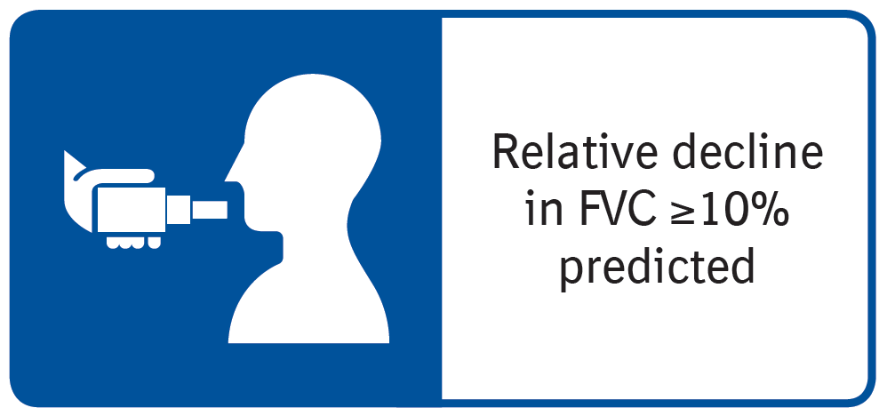
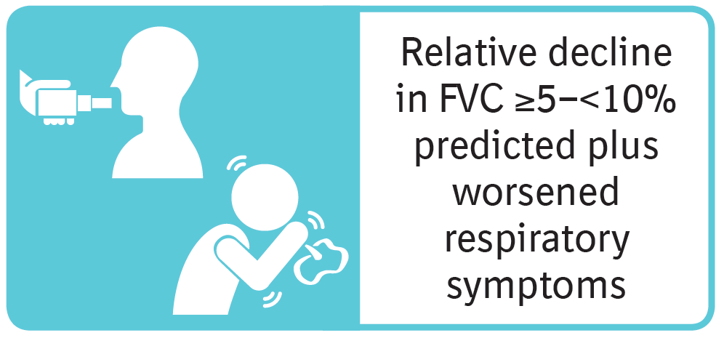
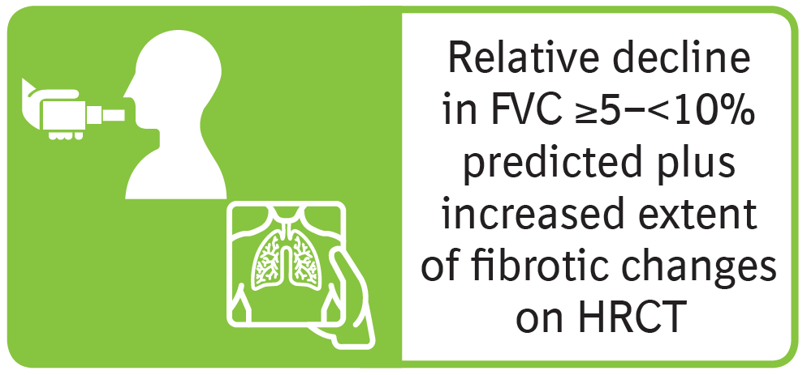
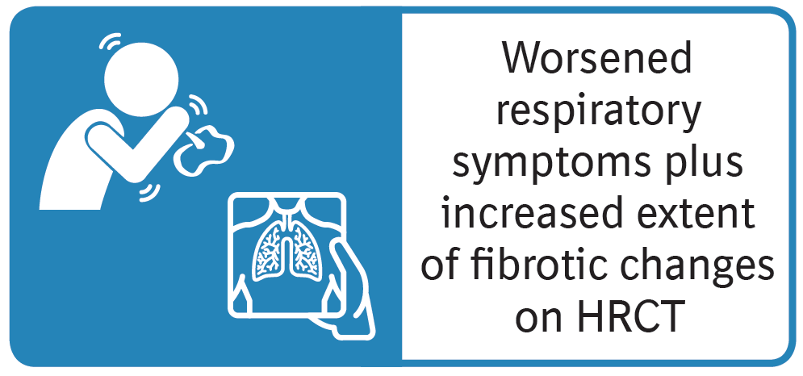
Design of the ILD-PRO Registry (3/3)
Patients must meet ≥1 of the following criteria for ILD progression in the past 24 months:
Palmer S et al. Improving our understanding of progressive fibrosing interstitial lung diseases (ILDs): design of the ILD-PRO Registry. Poster developed for the American Thoracic Society International Conference, 2020.

Slide 8
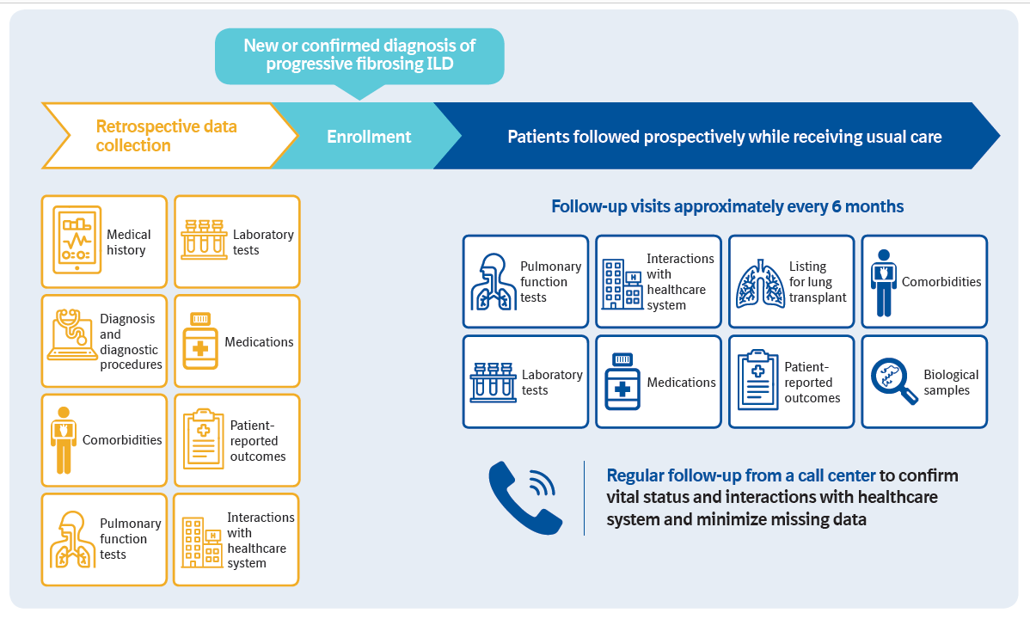
Data collection
Data from the prior 24 months will be collected at enrollment
Patients will then be followed prospectively while receiving usual care
Biological samples, including DNA, RNA and plasma, will also be collected
Palmer S et al. Improving our understanding of progressive fibrosing interstitial lung diseases (ILDs): design of the ILD-PRO Registry. Poster developed for the American Thoracic Society International Conference, 2020.

Slide 9
The IPF-PRO/ILD-PRO Registry will provide a better understanding of the natural history of chronic progressive fibrosing ILDs, their impact on patients, and current practices in their diagnosis and management
Collection of biological samples will provide the opportunity to discover diagnostic, prognostic and theragnostic biomarkers
Palmer S et al. Improving our understanding of progressive fibrosing interstitial lung diseases (ILDs): design of the ILD-PRO Registry. Poster developed for the American Thoracic Society International Conference, 2020.

Slide 10
Acknowledgements
The ILD-PRO Registry is funded by Boehringer Ingelheim Pharmaceuticals, Inc (BIPI) and coordinated by the Duke Clinical Research Institute
Editorial and formatting assistance, supported financially by BIPI, were provided by Julie Fleming and Wendy Morris of FleishmanHillard Fishburn, London, UK during the preparation of these slides and the poster on which these slides were based. The authors meet criteria for authorship as recommended by the International Committee of Medical Journal Editors (ICMJE), received no direct compensation for the development of the poster, were fully responsible for all content and editorial decisions, were involved at all stages of development and have approved the final version. BI was given the opportunity to review the poster for medical and scientific accuracy as well as intellectual property considerations.

Slide 11
ILD-PRO Registry enrolling centers
Albany Medical Center, Albany, NY; Baylor College of Medicine, Houston, TX; Baylor University Medical Center at Dallas, Dallas, TX; Cleveland Clinic, Cleveland, OH; Columbia University Medical Center/New York Presbyterian Hospital, New York, NY; Duke University Medical Center, Durham, NC; Froedtert & The Medical College of Wisconsin Community Physicians, Milwaukee, WI; Houston Methodist Lung Center, Houston, TX; Lahey Clinic, Burlington, MA; Loyola University Health System, Maywood, IL; Lynchburg Pulmonary Associates, Lynchburg, VA; Medical University of South Carolina, Charleston, SC; National Jewish Health, Denver, CO; NYU Medical Center, New York, NY; Piedmont Healthcare, Austell, GA; Ponce Research Institute, Ponce, Puerto Rico; Pulmonary Associates of Stamford, Stamford, CT; PulmonIx LLC, Greensboro, NC; Renovatio Clinical, The Woodlands, TX; Salem Chest and Southeastern Clinical Research Center, Winston Salem, NC; South Miami Hospital, South Miami, FL; St. Joseph’s Hospital, Phoenix, AZ; Stanford University, Stanford, CA; Temple University, Philadelphia, PA; The Oregon Clinic, Portland, OR; Thomas Jefferson University, Philadelphia, PA; Tulane University, New Orleans, LA; UNC Chapel Hill, Chapel Hill, NC; University of Alabama at Birmingham, Birmingham, AL; University of California, Davis, Sacramento, CA; University of California Los Angeles, Los Angeles, CA; University of Chicago, Chicago, IL; University of Cincinnati Medical Center, Cincinnati, OH; University of Louisville, Louisville, KY; University of Miami, Miami, FL; University of Michigan, Ann Arbor, MI; University of Minnesota, Minneapolis, MN; University of Pennsylvania, Philadelphia, PA; University of Pittsburgh, Pittsburgh, PA; University of Virginia, Charlottesville, VA; UT Southwestern Medical Center, Dallas, TX; Vanderbilt University Medical Center, Nashville, TN; Vermont Lung Center, Colchester, VT; Wake Forest University, Winston Salem, NC; Washington University, St. Louis, MO; Weill Cornell Medical College, New York, NY; Wilmington Health and PMG Research, Wilmington, NC; Yale School of Medicine, New Haven, CT.

